Slide 1
Track: Oracle Digital Accounting Specialist Group Code: NXT19_CAI2_ERP4_S2

Slide 2
Team Members
Fady Micheal Hezkial Abdallah.
Momen Bishr Mohammed Abdelhamed.
Mohamed Abdelhaleem Abdelhaleem Ahmed.
Shehab Mohamed Mohamed Omara.
Mohammed Ismail Nasrallah Abdelrahman.

Slide 3

Project Title
Implementation of Oracle General Ledger in the ERP Server for Enhanced Financial Operations in (City Home) (Home Electronics Sales).

Slide 4
Item | Before Using ERP System | After Using ERP System (Oracle GL)
Work System | Traditional (Excel files and paper records) | Centralized and automated system using Oracle ERP
Financial Data Accuracy | Prone to manual errors | High accuracy through structured input and automatic checks
Report Preparation Speed | Slow and time-consuming | Real-time and fast report generation
Journal Entries Management | Manual and fragmented | Supports multiple types (standard, recurring, reversing, etc.)
Approval Procedures | Unstandardized or nonexistent | Automated workflow for journal approvals
Budgeting | Basic and not integrated | Comprehensive budgeting and control within the system
Process Integration | Isolated between departments | Full integration across departments within one system
Access Control | Insecure, data accessible to everyone | Role-based access (e.g., Accountant, Manager)
Scalability | Difficult to keep up with business growth | Easily scalable with business expansion
Operational Costs | High due to errors and repetitive tasks | Reduced through process efficiency and automation
Decision-Making | Based on outdated or inaccurate data | Based on real-time reports and accurate data

Slide 5
SETUP
2.
3.
1.
Creating Calendar
Creating Chart of Accounts
Creating Currency

Slide 6
1.Creating Calendar

Slide 7
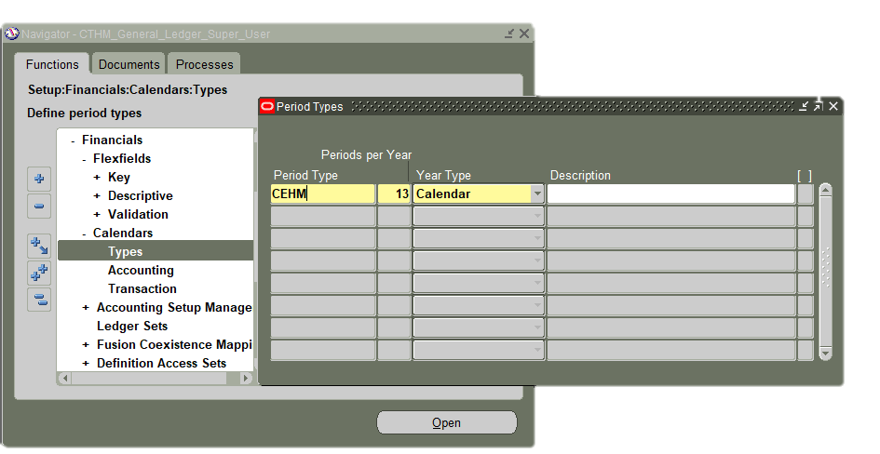
Creating Calendar
(a¹) Defining New Period Type:
N: Setup → Financials → Calendars → Types
1
Enter a unique name in the Name field to identify the accounting period type.
2
Periods per Year, enter the number of periods per year.
3
Choose Calendar from the Year Type field.
⚠ Note: If you're using an adjustment period, it must be taken into account. Add the number of adjustment periods to the total number of periods when defining the period type in the earlier step.

Slide 8
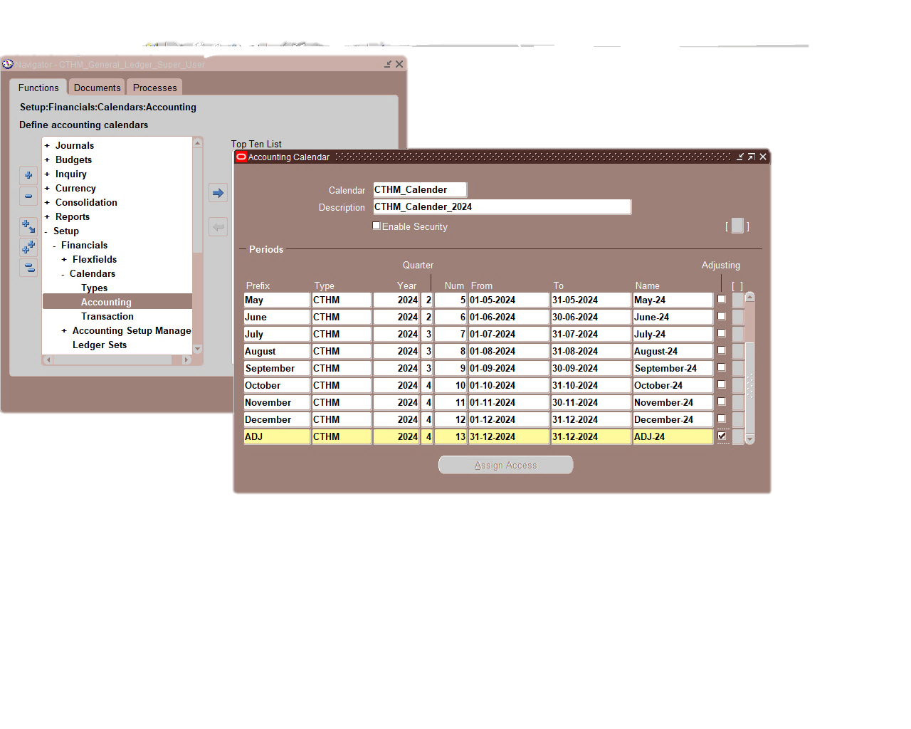
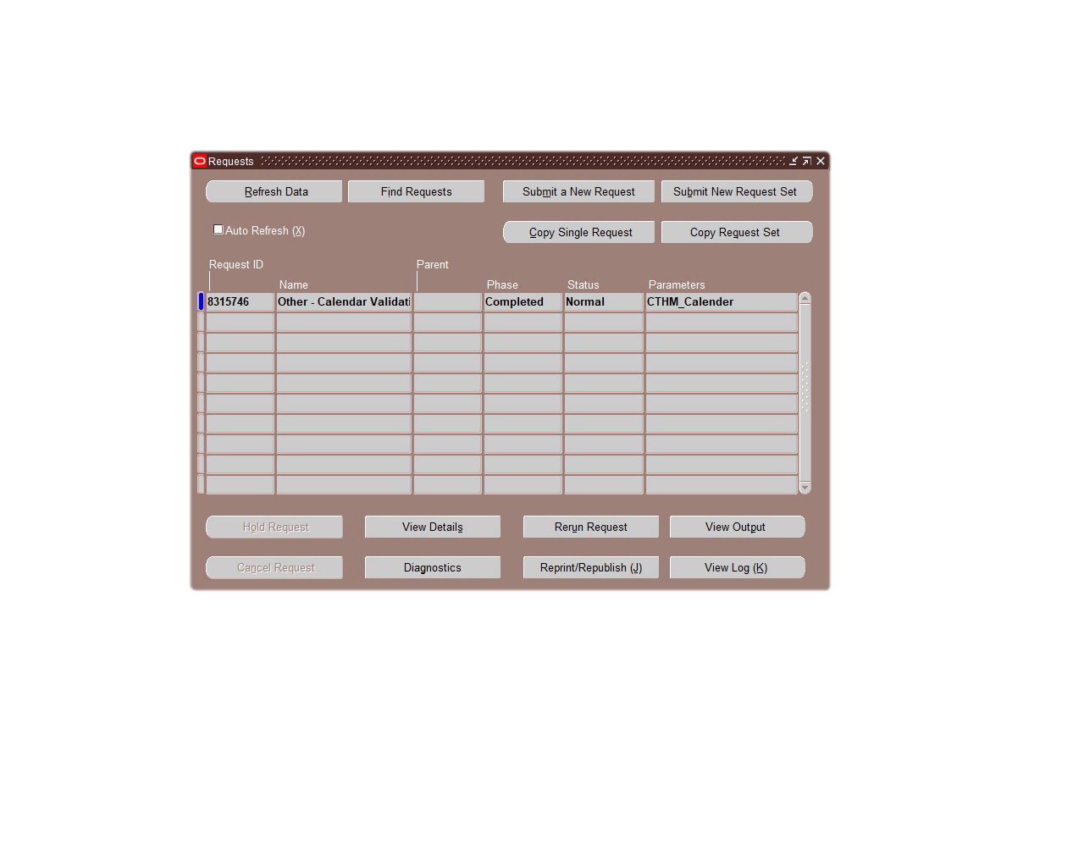
(B¹) Creating New Calendar:
N: Setup → Financials → Calendars → Accounting
1
1
Enter the desired calendar name.
2
Prefix: Enter the period name (e.g., May, June...). Type: Enter the name of the previously created Period Type. Quarter: Enter the quarter number to which the period belongs. Num: Enter the sequence number of the period, then specify the start date in From and the end date in To.
2
2
3
If the period is an Adjustment Period, check the corresponding Adjusting box.
5
verify a request

Slide 9
2.Creating Chart of Accounts

Slide 10
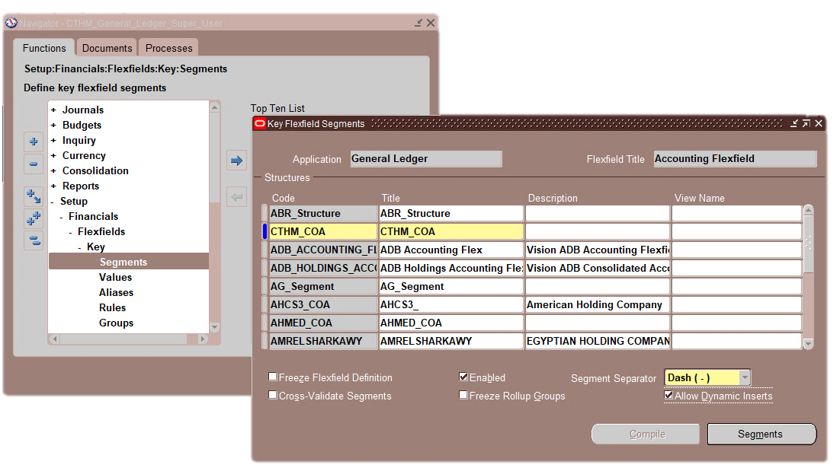
A²: Key Flexfield Segments Window
Key Flexfield Segments Window
N: Setup → Financials → Flexfields → Key → Segments
Use these windows to define the key Flexfield structure:
1
Query Application as General Ledger and Flexfield Title as Accounting Flexfield.
1
2
2
Place cursor on structures code click on new and enter the new structure name.
3
Enable Allow Dynamic Inserts.
3
4
Segments button.
4

Slide 11
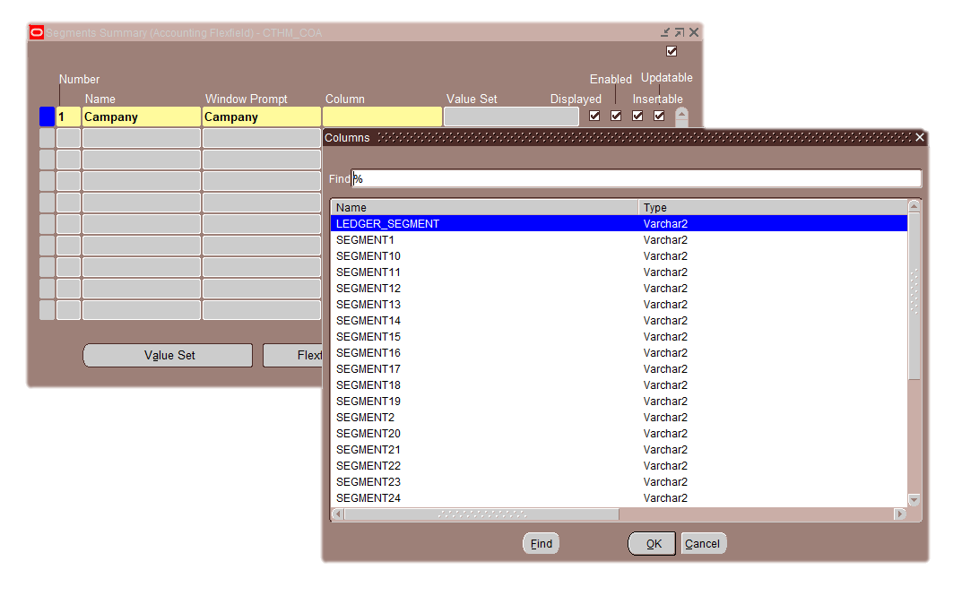
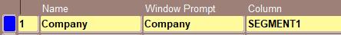
After clicking the Segments button, the Segments Summary window appears.
B²: Flexfield Qualifiers
1
2
1
Enter the segment Number and Name in the designated fields، In the
2
Click in the Column field, then select the appropriate SEGMENT column where the segment value will be stored.
🔔 Make sure to select a different Column for each segment.
Notes:
'Window Prompt' field, enter the name that will appear to the user when entering data."

Slide 12
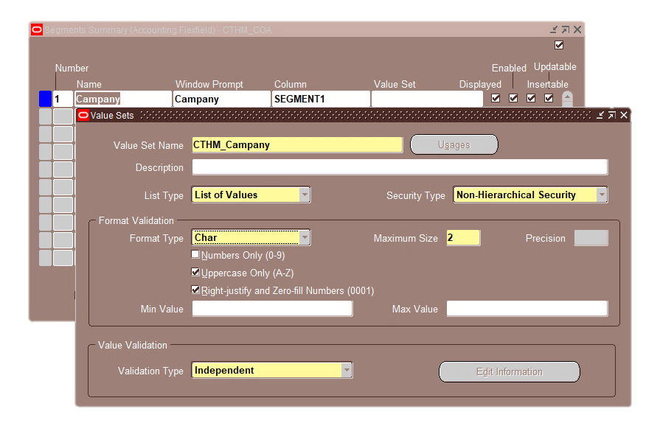
Value Sets window
After clicking on the Value Sets button:
1
Enter a unique name for the value set.
2
Choose security type: NON Hierarchical Security
1
In the Format Validation section: Choose the data type (Character or Number).
Set the maximum length of the value that can be entered for the segment.
2
3
3
4
4
Select "Independent" from the Validation Type: This type is used to define a set of predefined values. Users must select from this list and cannot enter any value outside of it.
Notes:
The Value Sets window is used to define the types of values that can be entered for each Segment, such as numbers, characters, or values within a specific range.

Slide 13
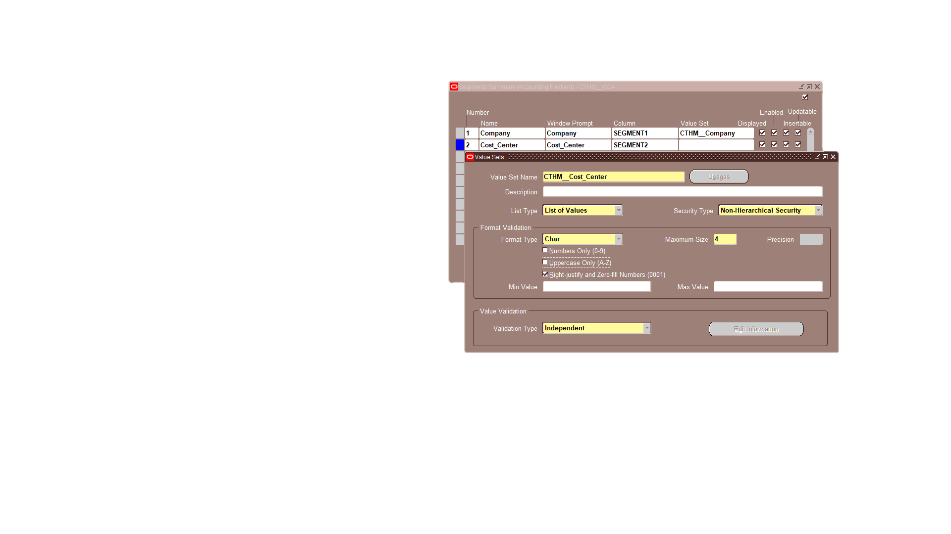
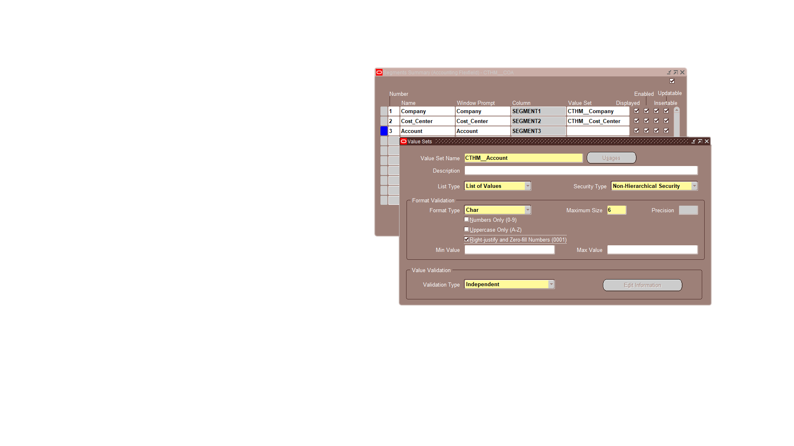
Choose Parent when the value represents a total or a category that includes more than one other value.

Slide 14
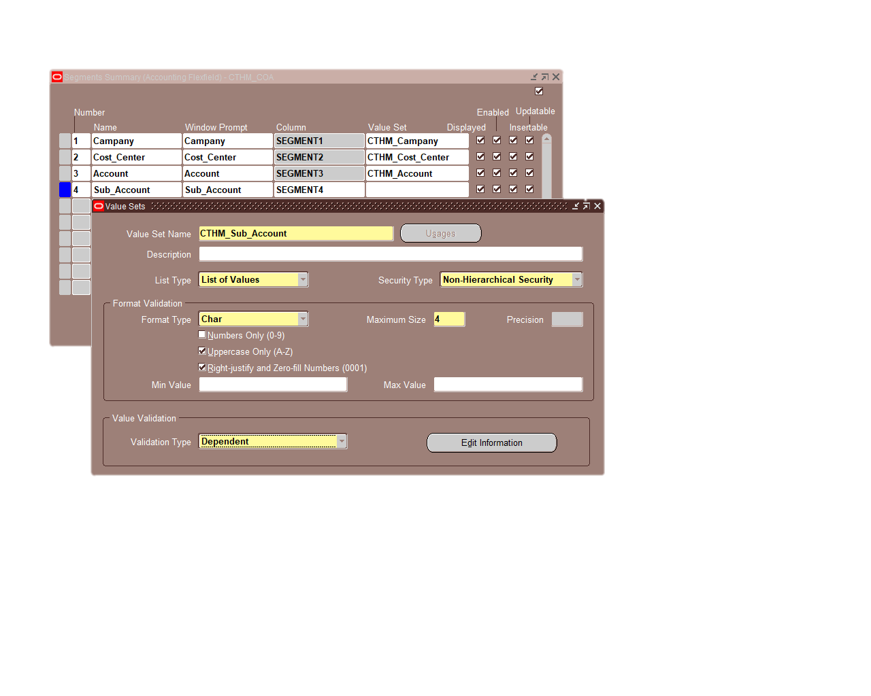
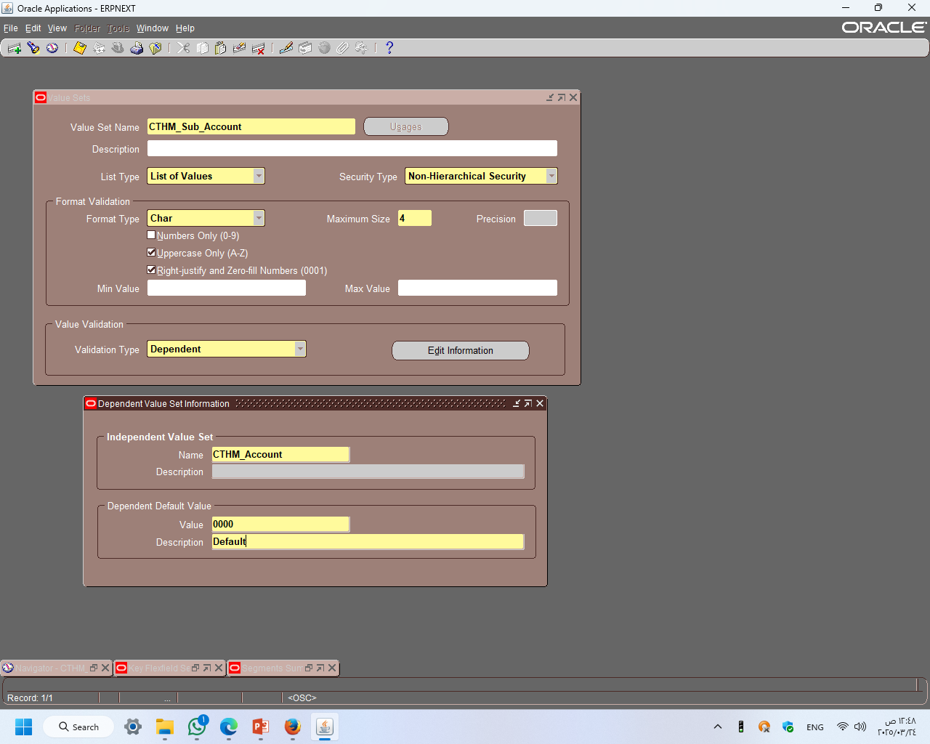
Make Sub Account
The main difference in the Sub_Account field appears in:
Validation Type: It is set to Dependent instead of Independent.
🔕This means that the available values in this segment depend on a specific value selected from a Parent Value Set.
1
Click on the Edit Information button.
1
2
Select the Parent Value Set that this value set will depend on.
2

Slide 15
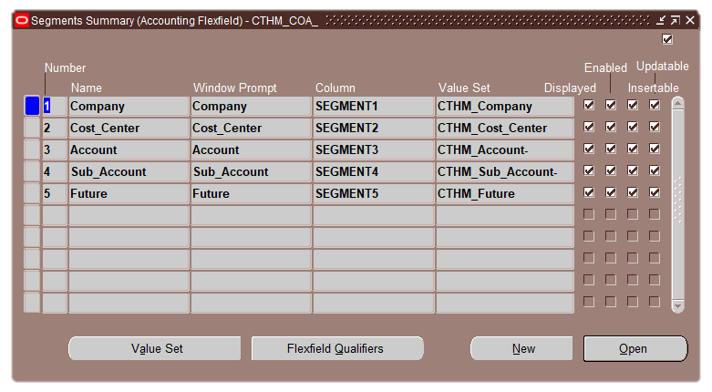
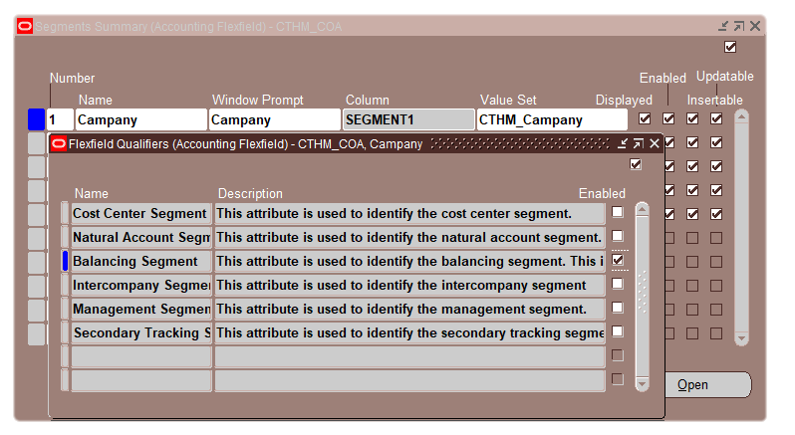
C²: Flexfield Qualifiers
Click the Flexfield Qualifiers button.
Company select→ Balancing
Click Enabled

Slide 16
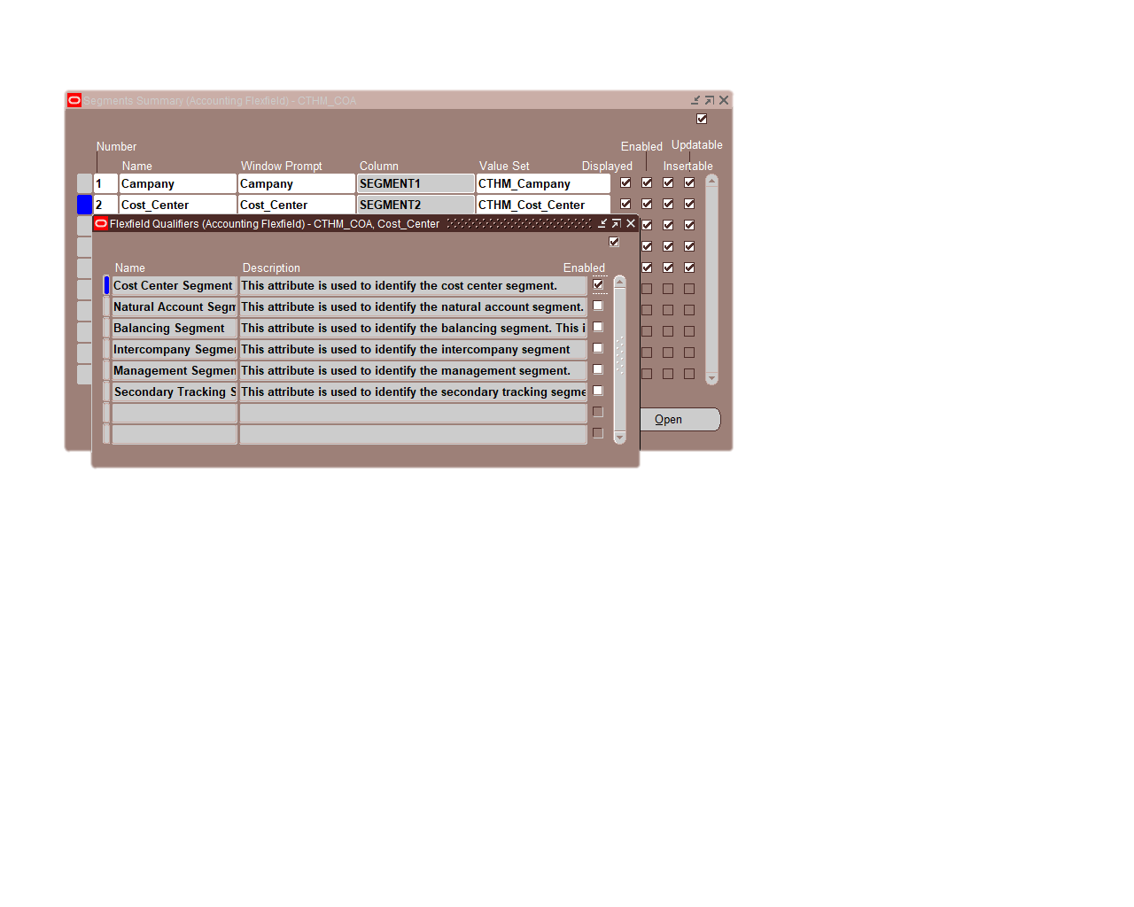
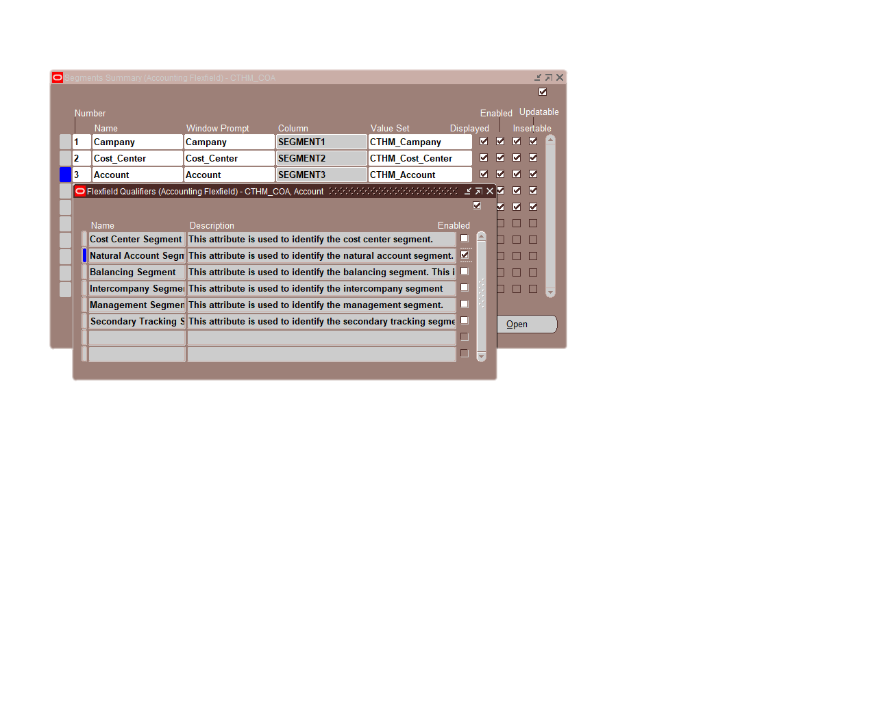
Cost_Center select → Cost Center
Account select → Natural Account
Click Save and then close the window.

Slide 17
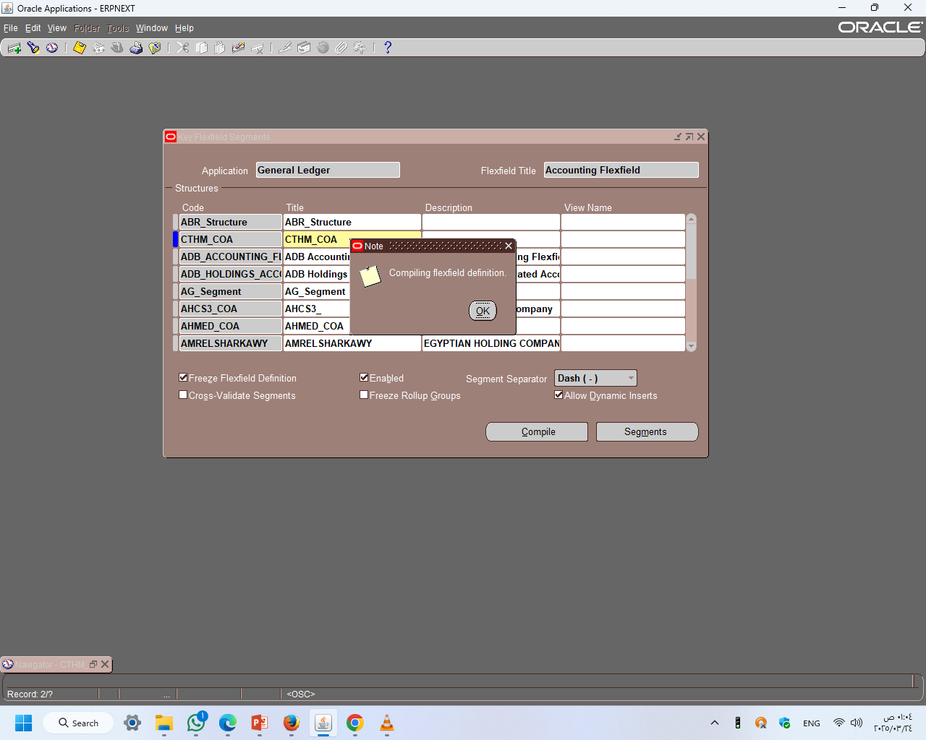
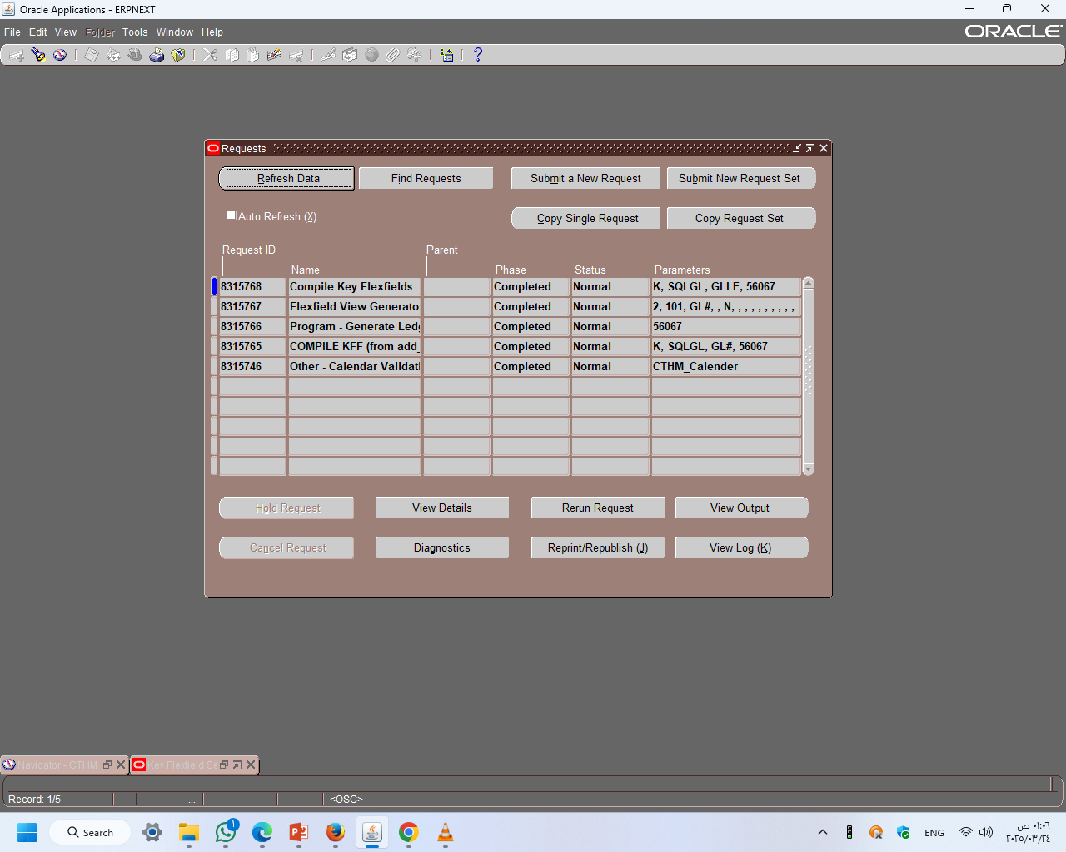
1
Select Freeze Flexfield Qualifiers
2
Select Freeze Flexfield Qualifiers
3
3
Click ok
1
2
Go to the reports window
Menu → View → Requests

Slide 18
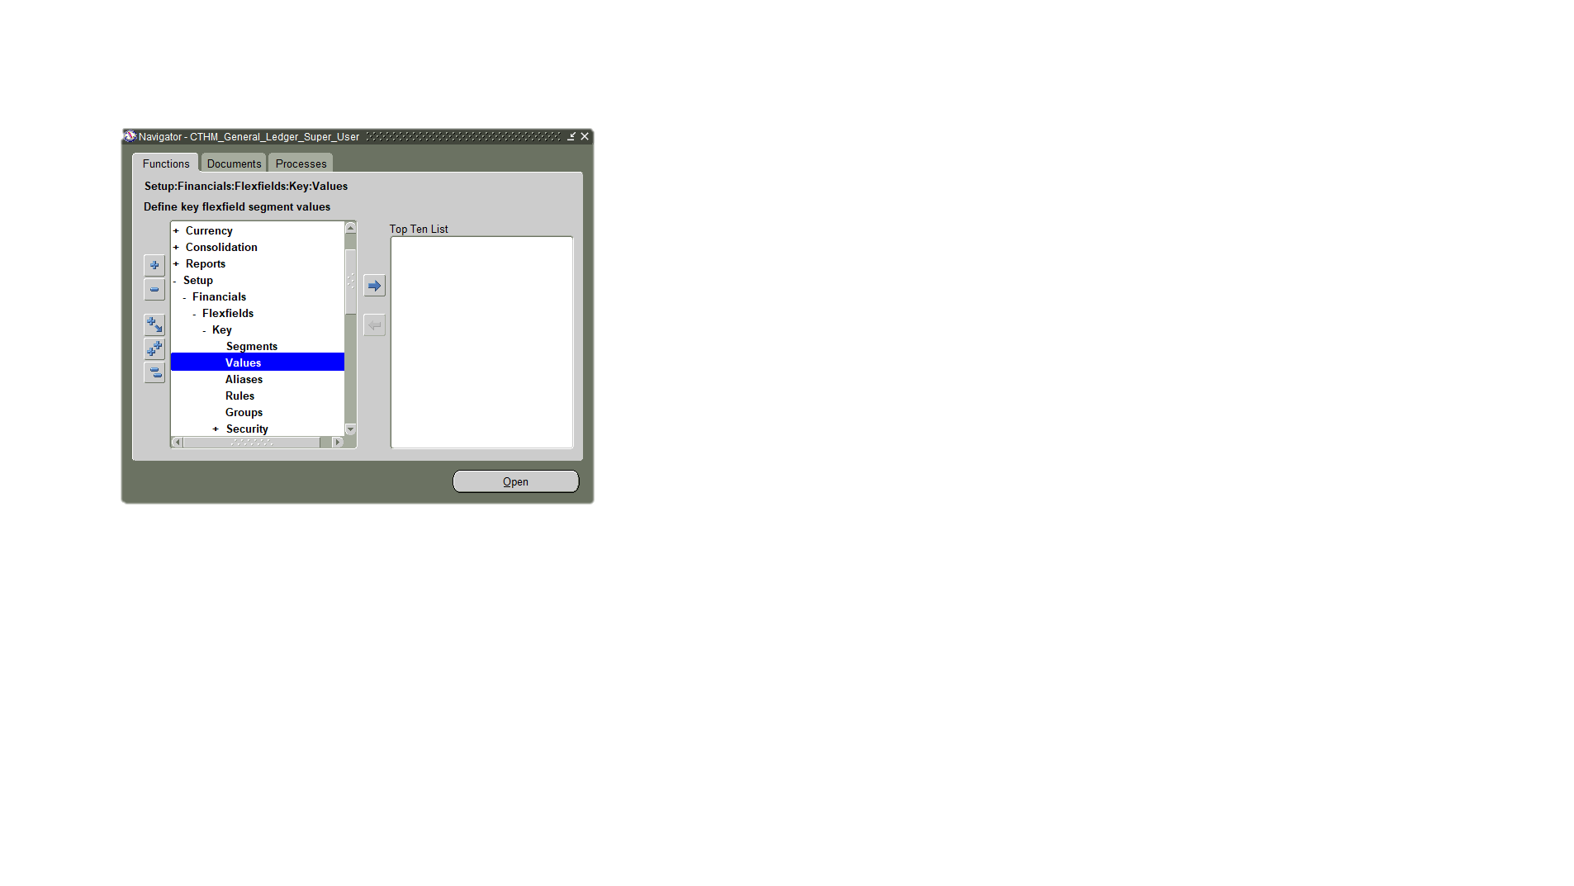
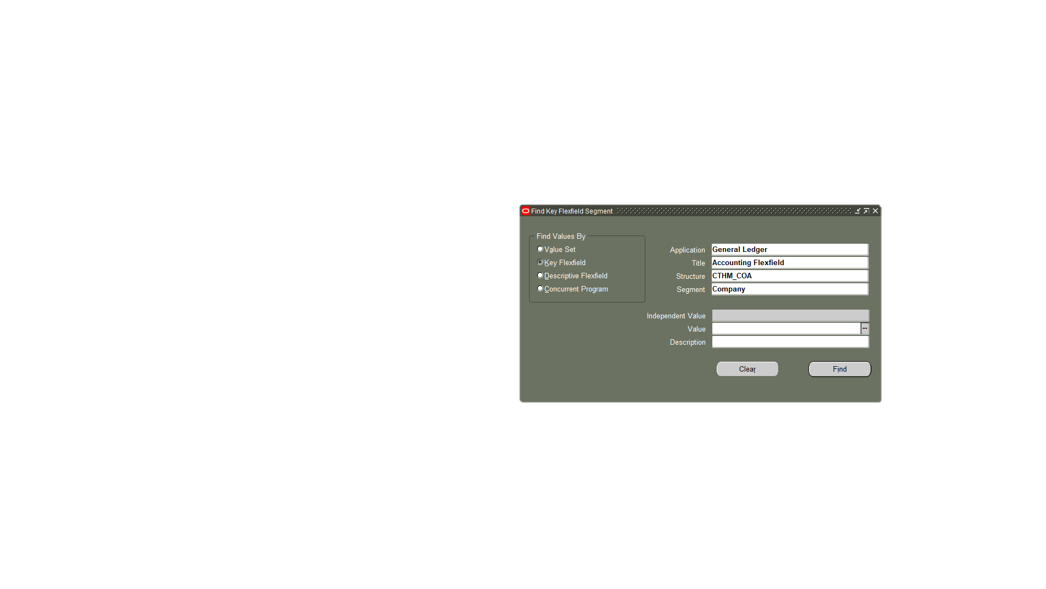
Key Flexfield window
N: Setup → Financials→ Flexfields → key → Values
Enter:
Application: General Ledger
Title: Accounting Flexfield
Structure: CTHM_COA
Select Segment
Click on Find

Slide 19
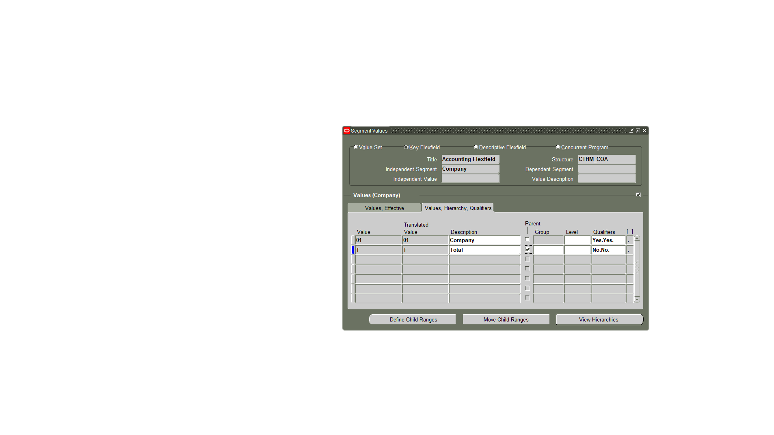
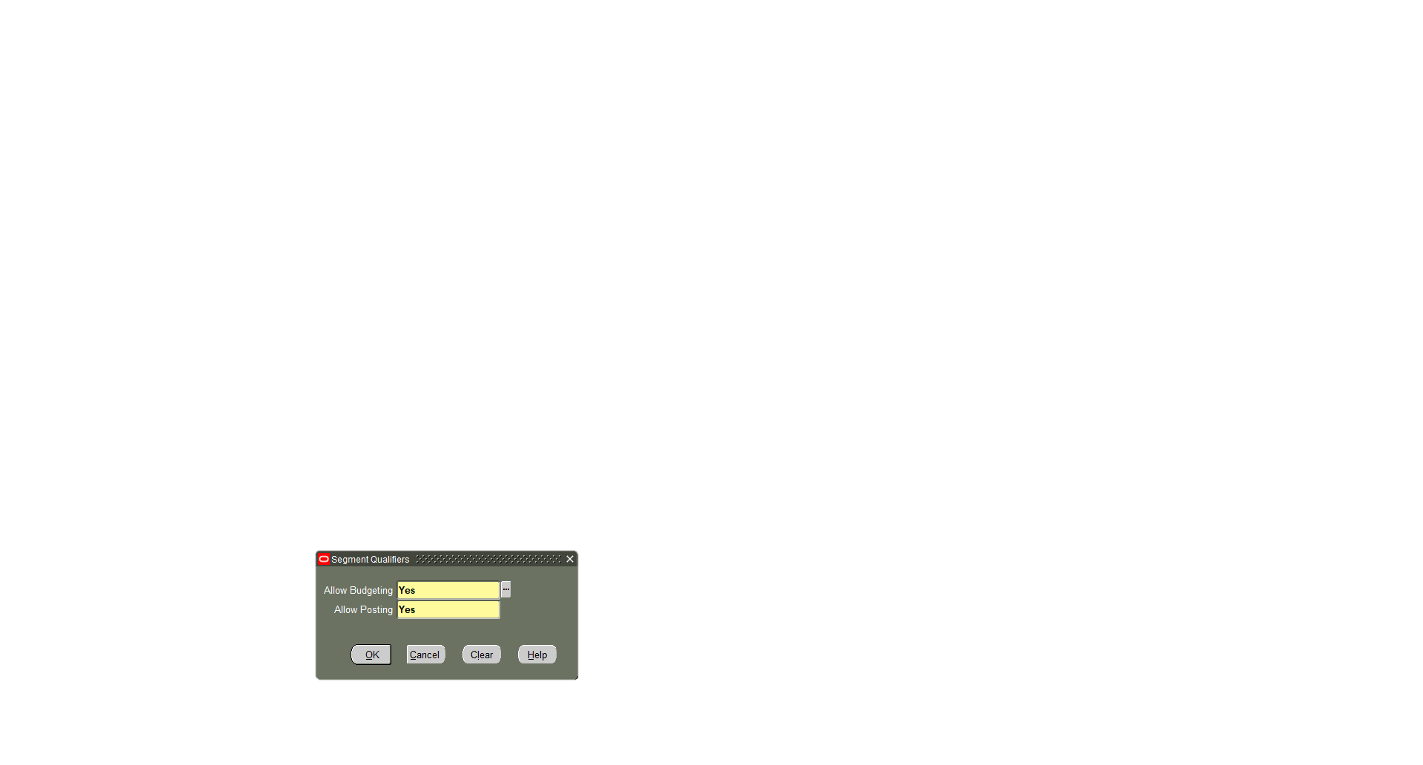
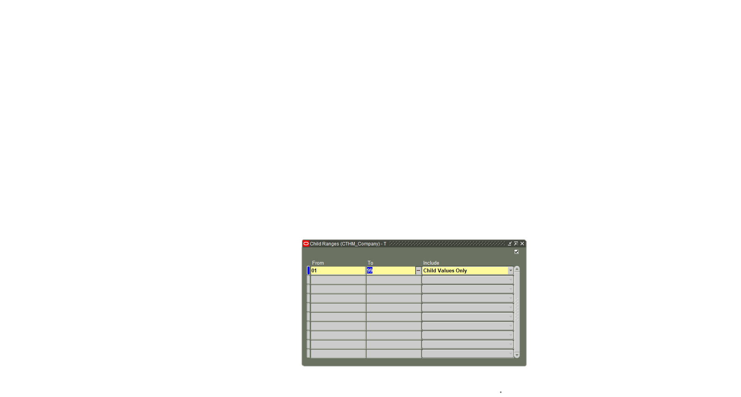
1
Enter value & Company name in Description
2
Choose Parent when the value represents a total or a category that includes more than one other value.
3
1
3
Enter Qualifiers
If the account is not a Parent, select Allow Posting = Yes and Allow Budgeting = Yes. If the account is a Parent, select No for both.
4
4
Click Define Child Ranges
5
Enter the range of values to be included as children under the parent account.
5

Slide 20
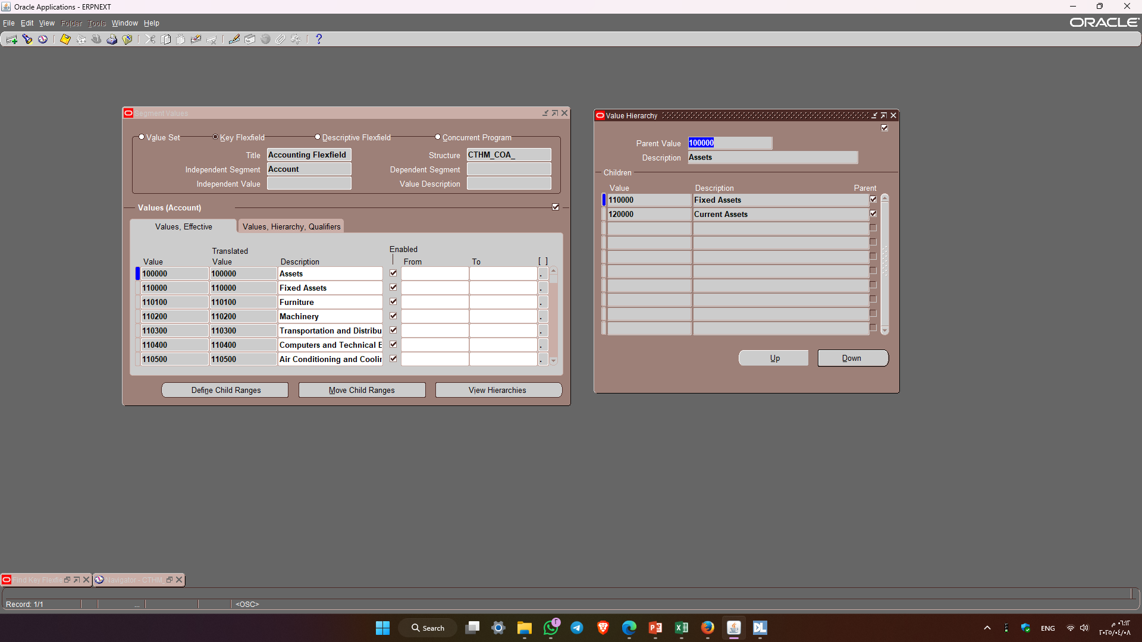
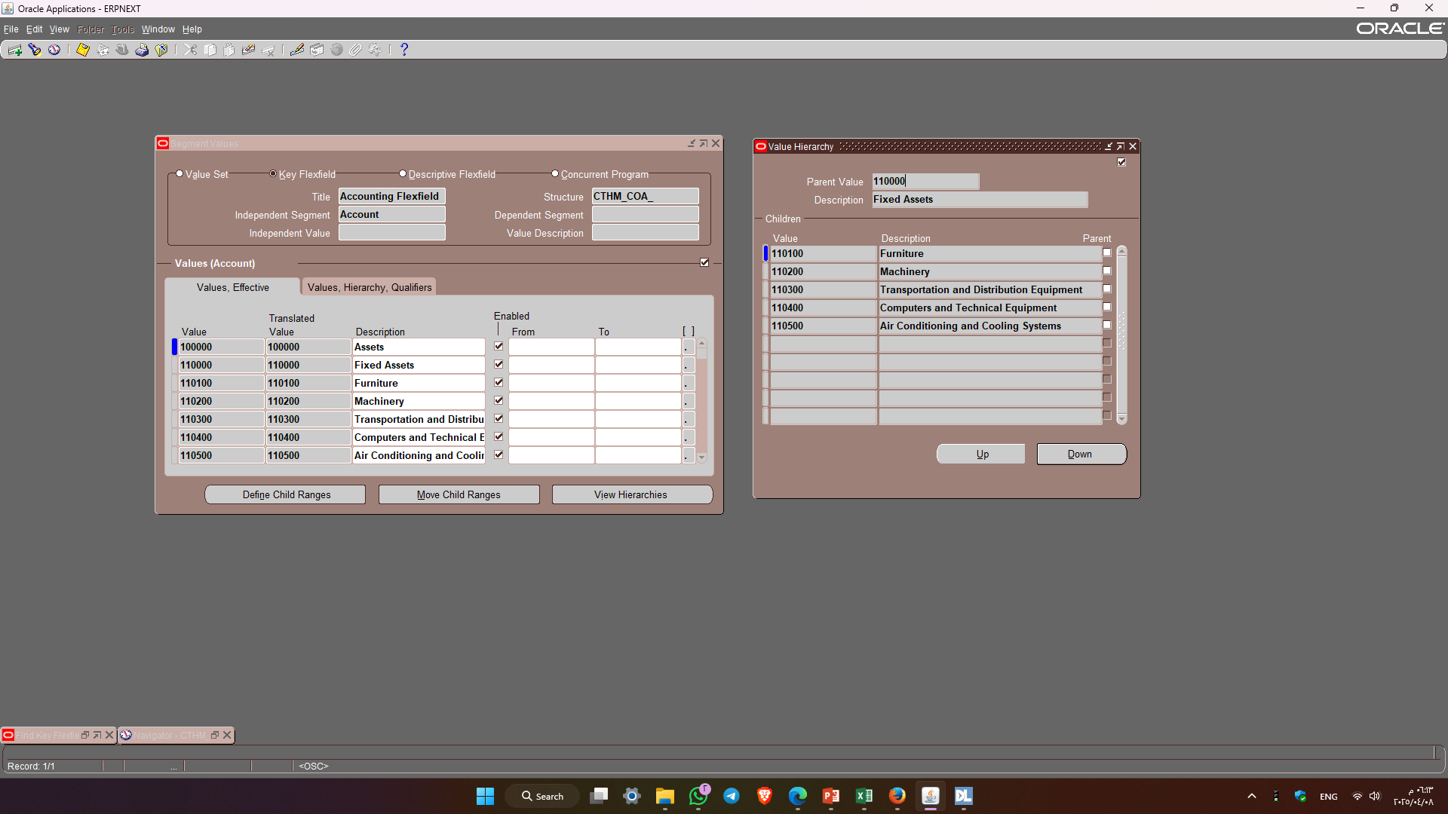
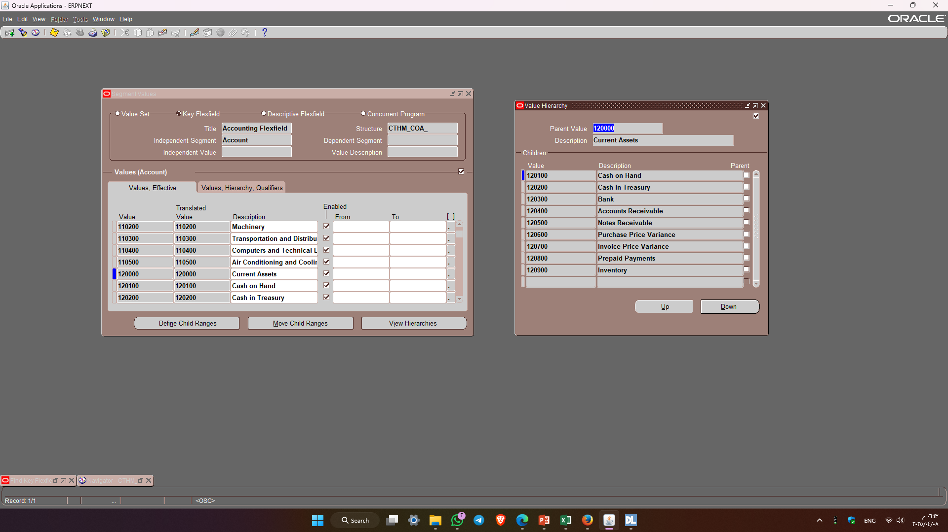
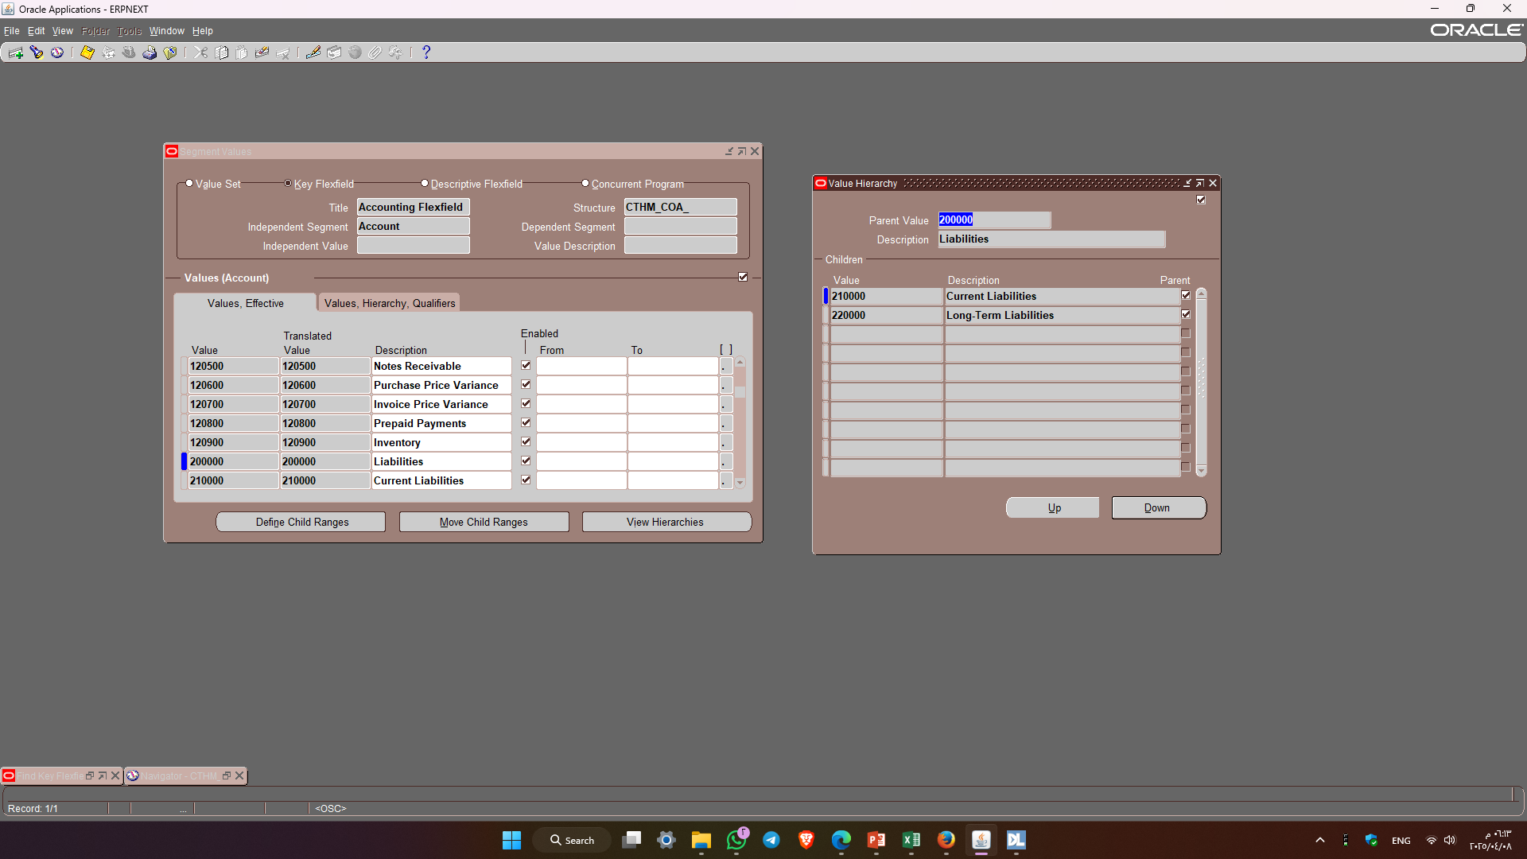
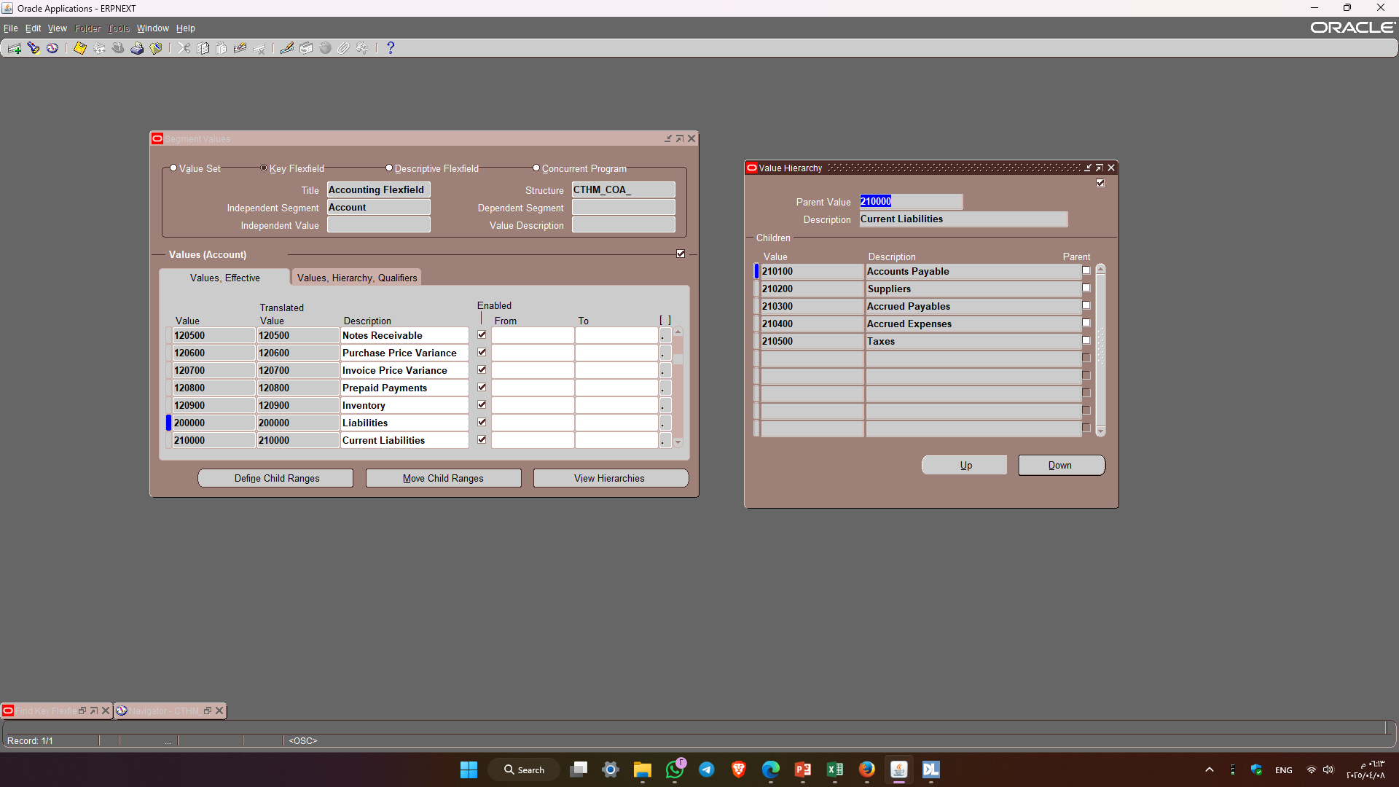
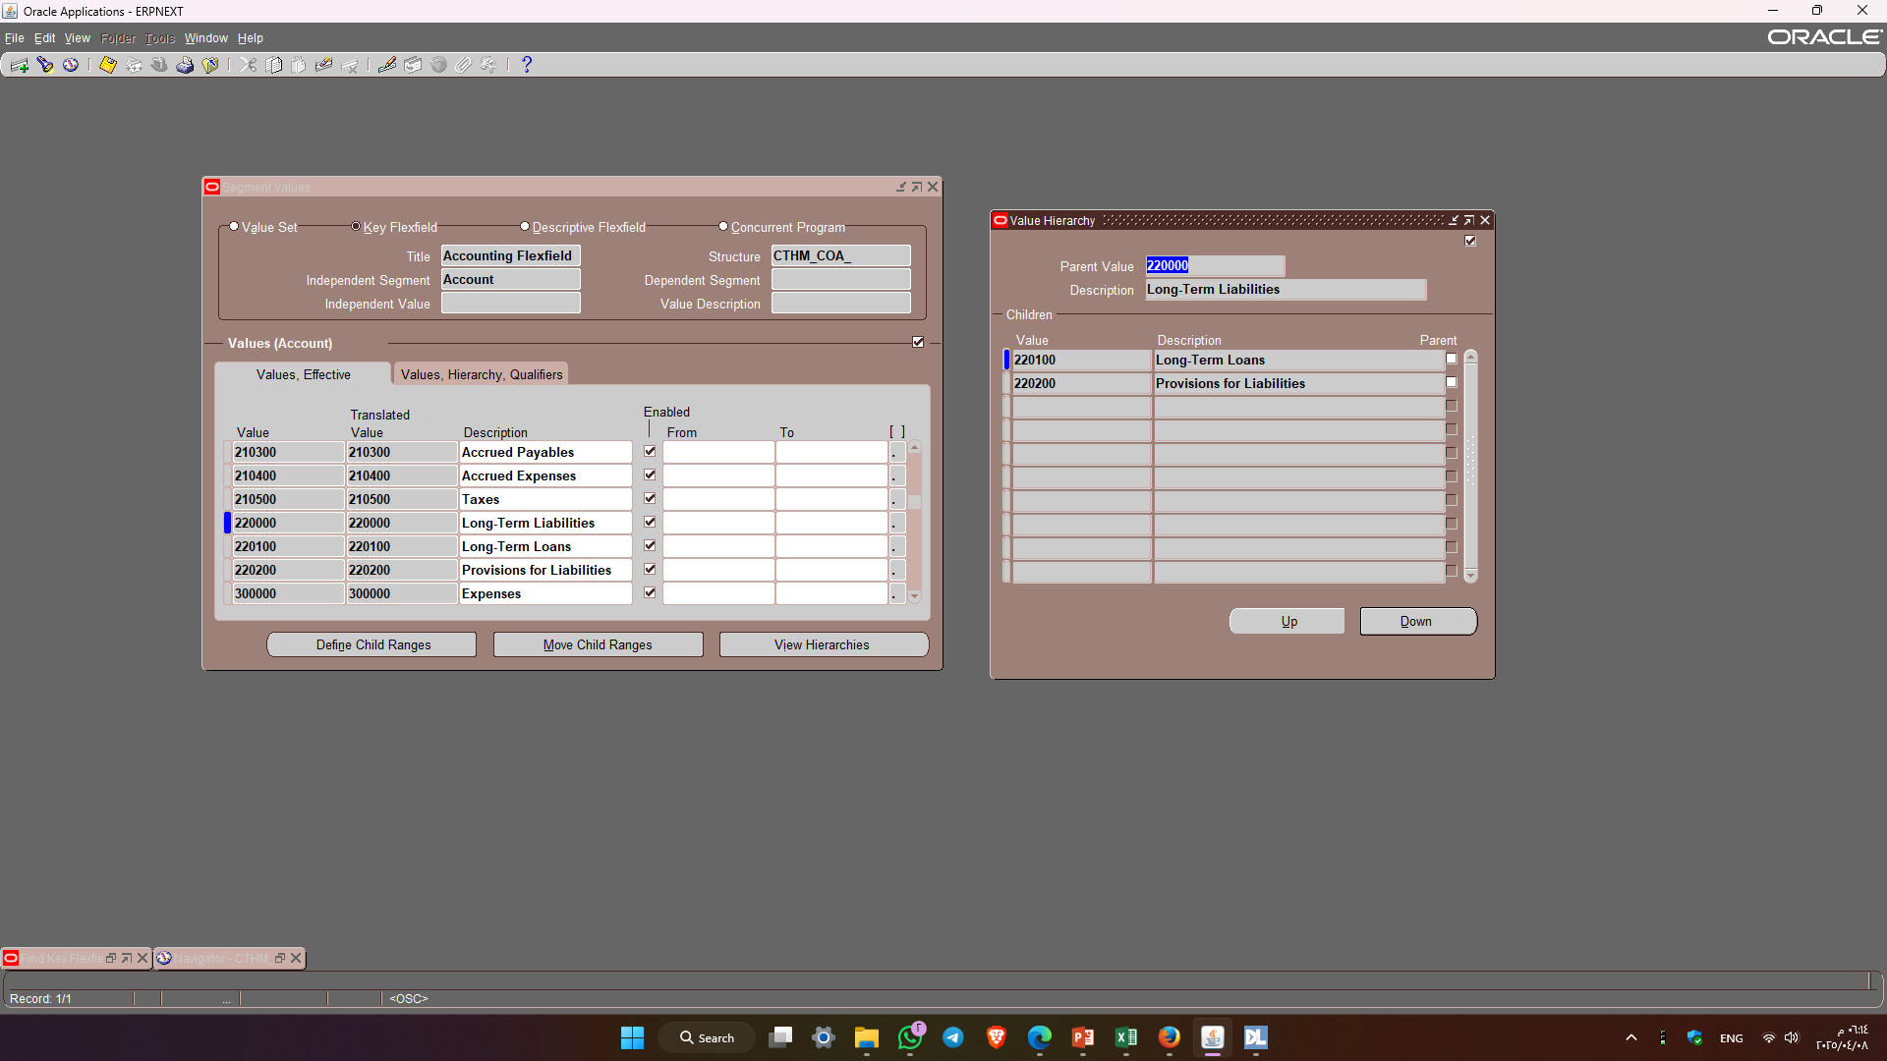

Slide 21
Accounting Setup

Slide 22
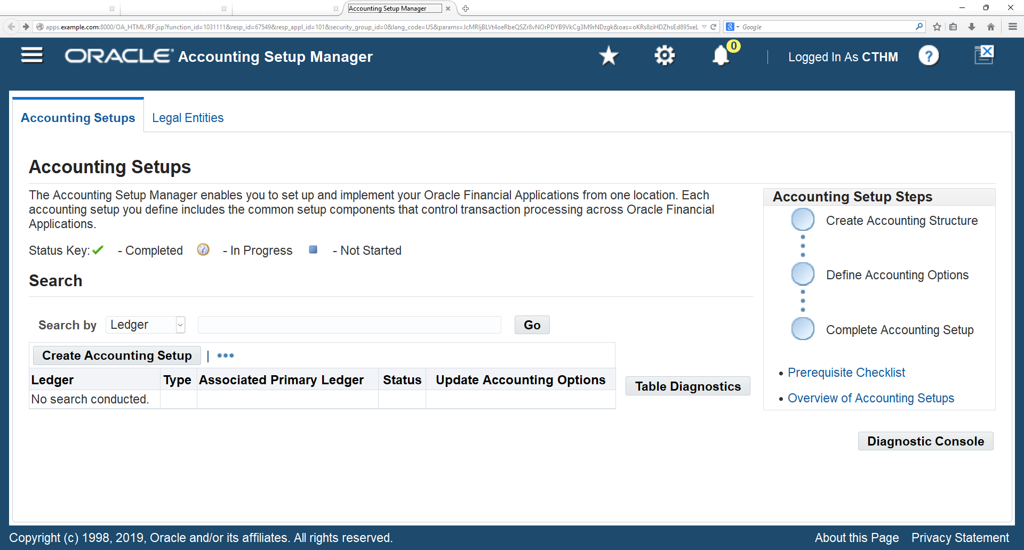
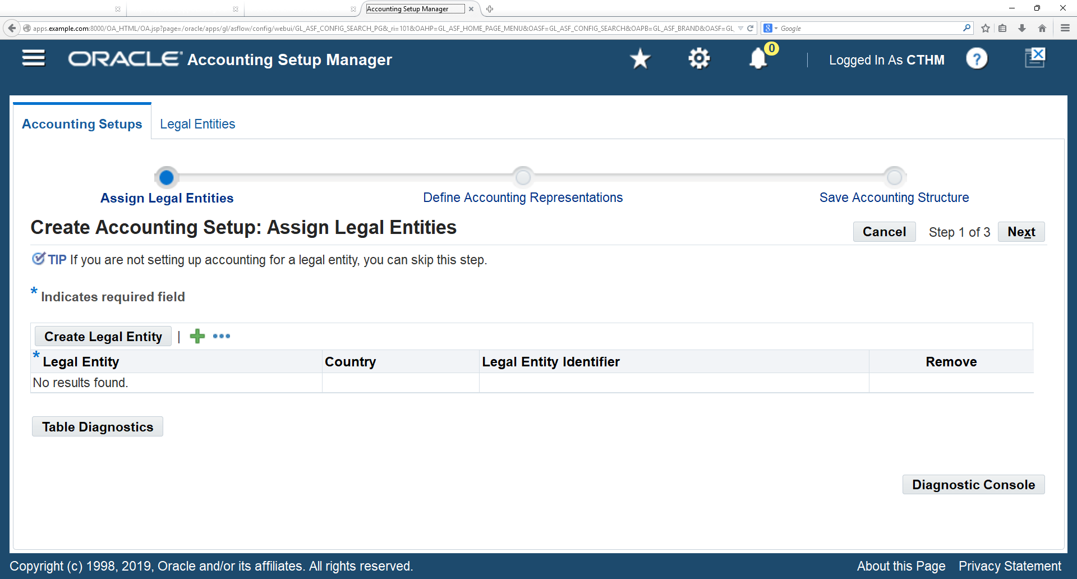
1
Click on “Create Accounting Setup” button
2
Click on “create Legal Entity” button

Slide 23
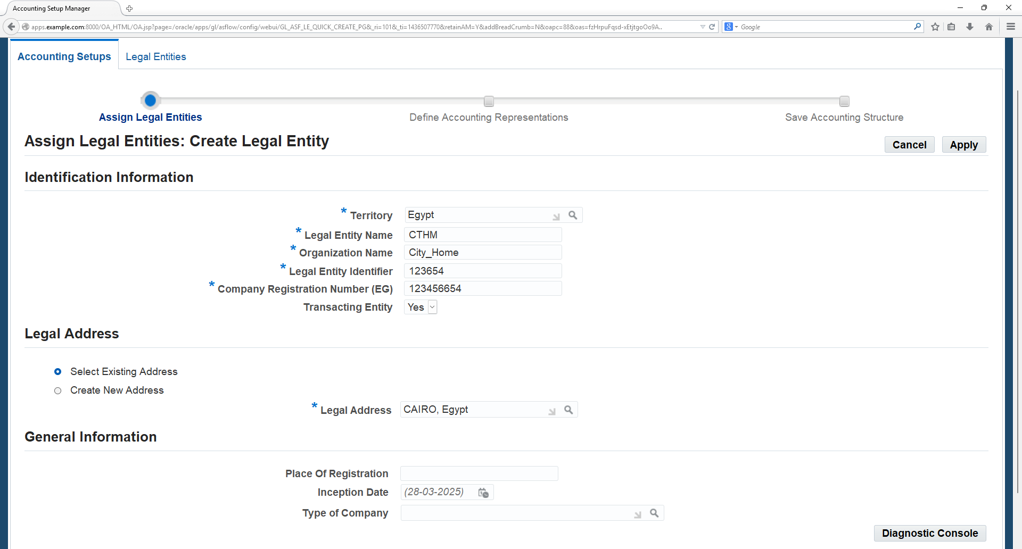
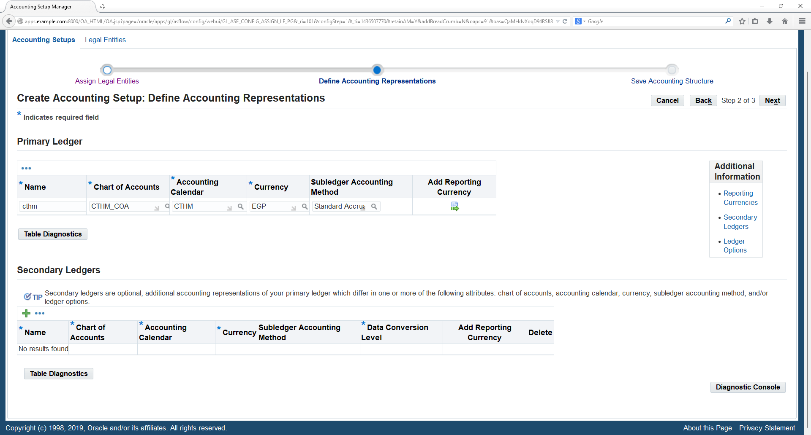
3
Enter the Territory as United States then enter the Legal Entity information as seen in above screen.
Enter the address then Click on „Save and Add Details‟ and Apply
4
5
Enter the Primary Ledger name as CTHM, Chart of Accounts as CTHM_COA, Accounting Calendar as CTHM_Calendar, Currency as EGP, and Subledger Accounting Method as Standard Accrual, then Click on Next button.

Slide 24
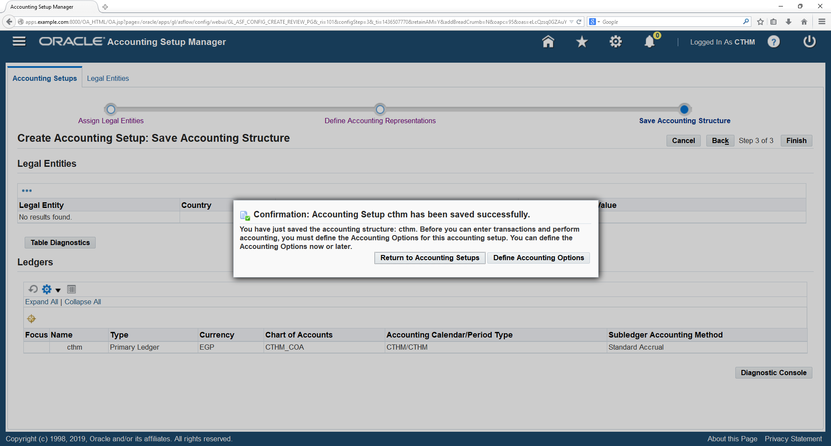
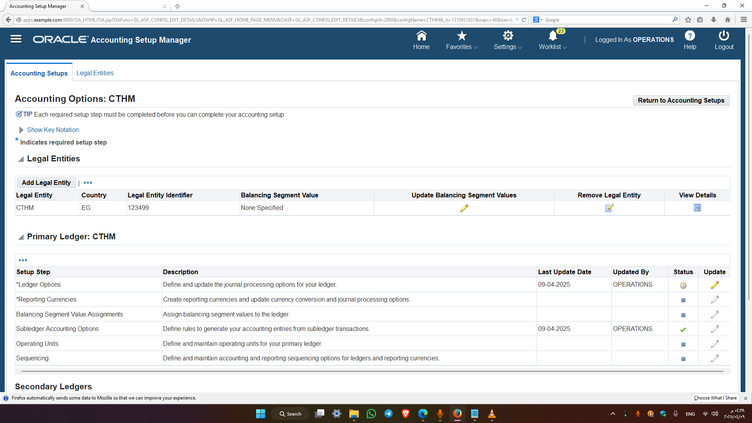
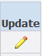
6
Save Accounting Structure by clicking on Finish button
7
Click on Define Accounting Options button
8
Select the Setup step as Ledger Options and click on Update icon

Slide 25
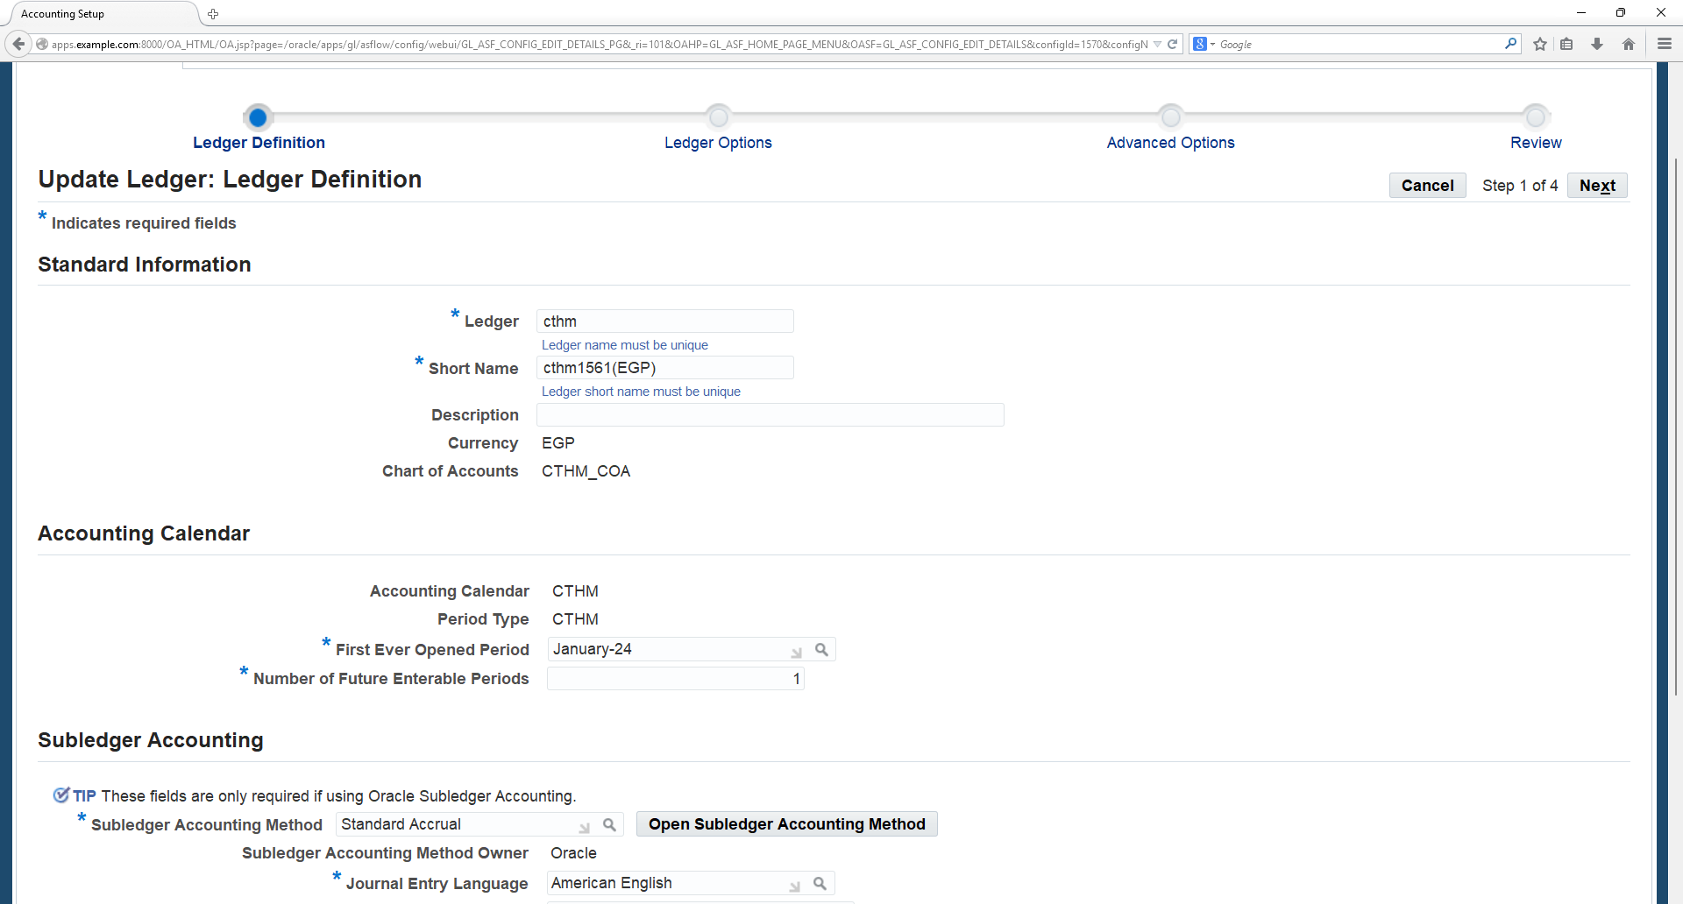
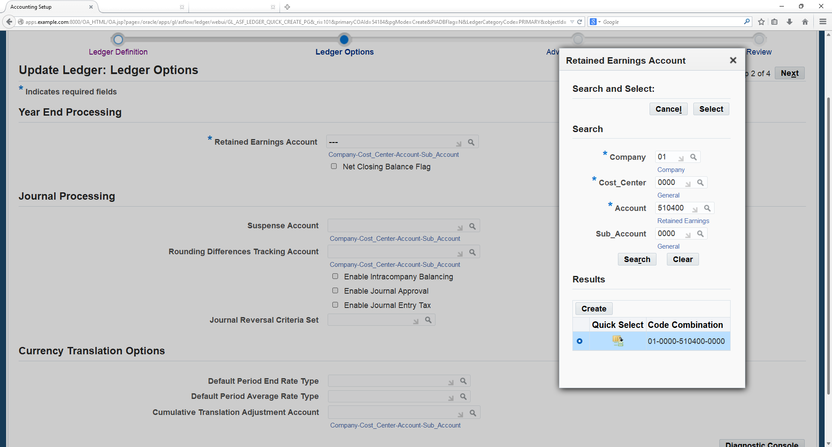
9
Check the Ledger options and enter the First ever opened period and Number of Future enabled periods as 1 and enter the Subledger Accounting Method as Standard Accrual then click on Next button.
10
Enter the Retained Earnings Account Code combination then click on Next button

Slide 26
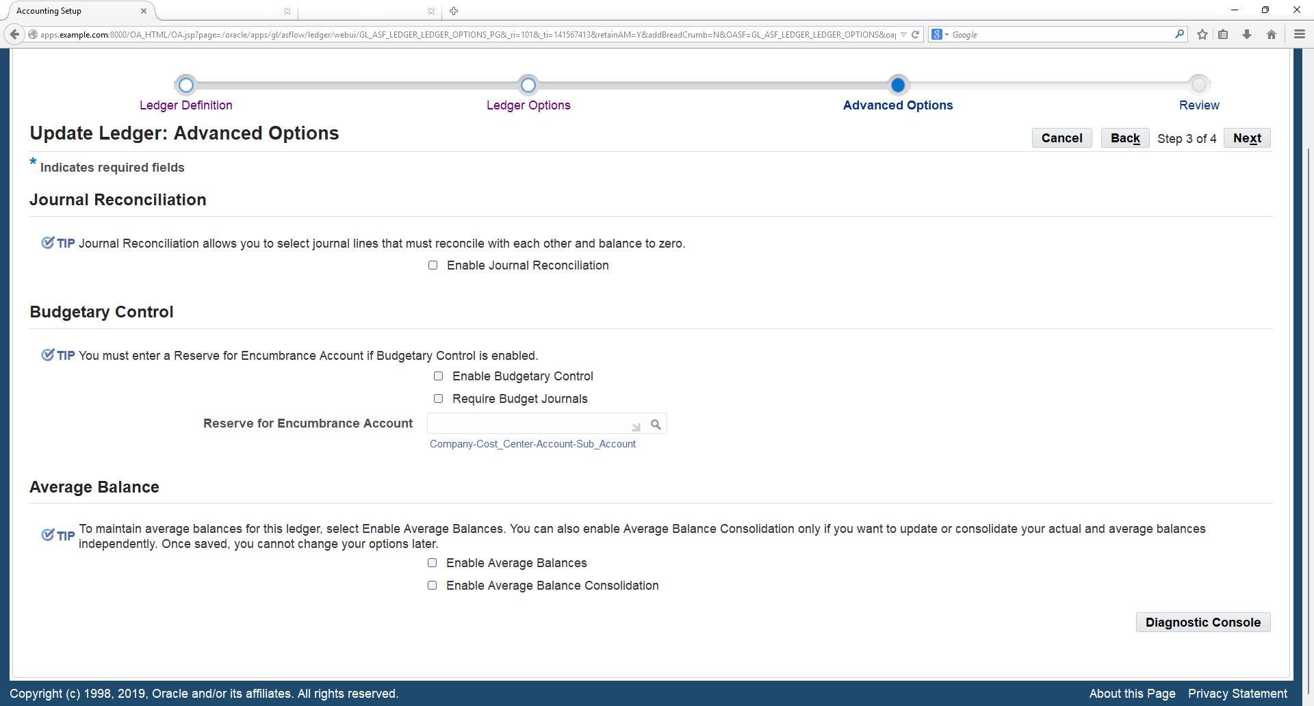
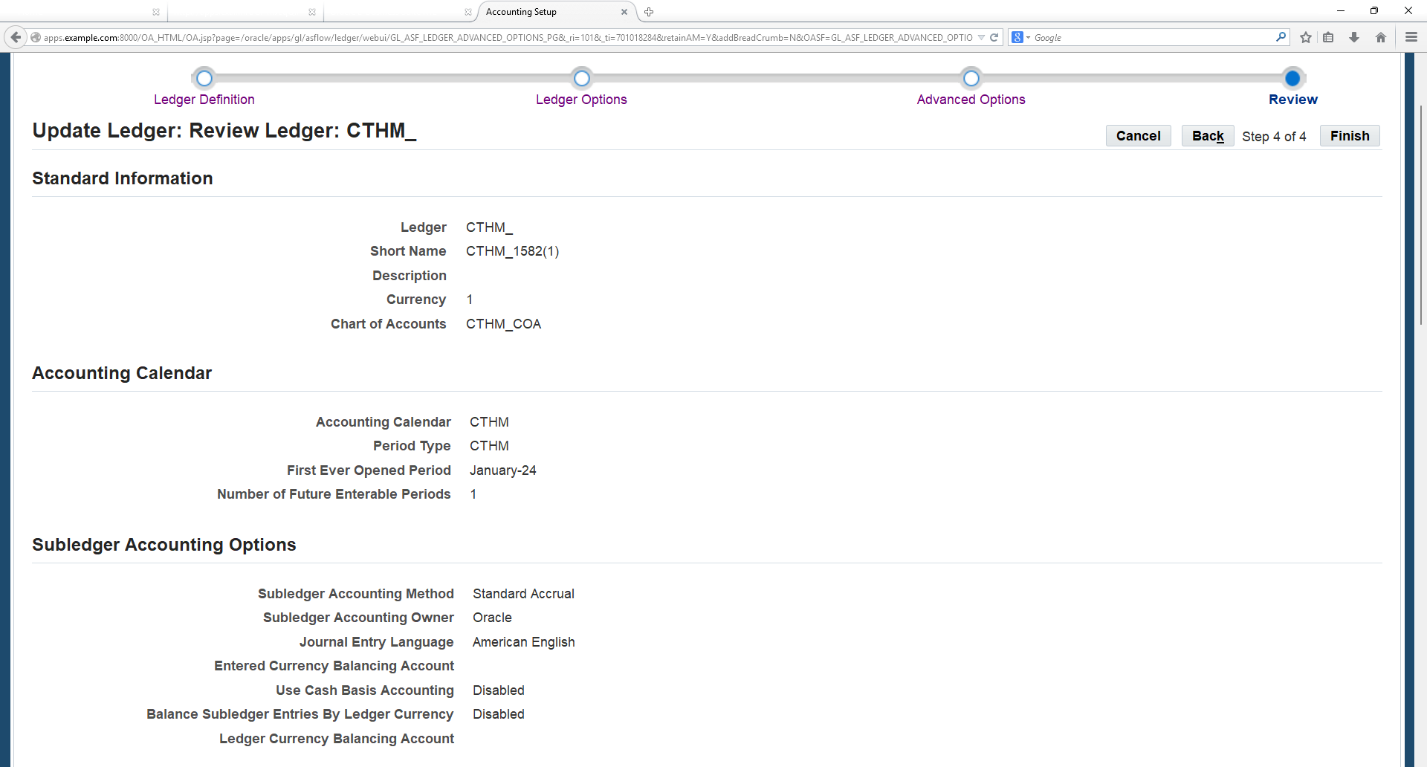
11
Click on Next button
12
Click on Finish button

Slide 27
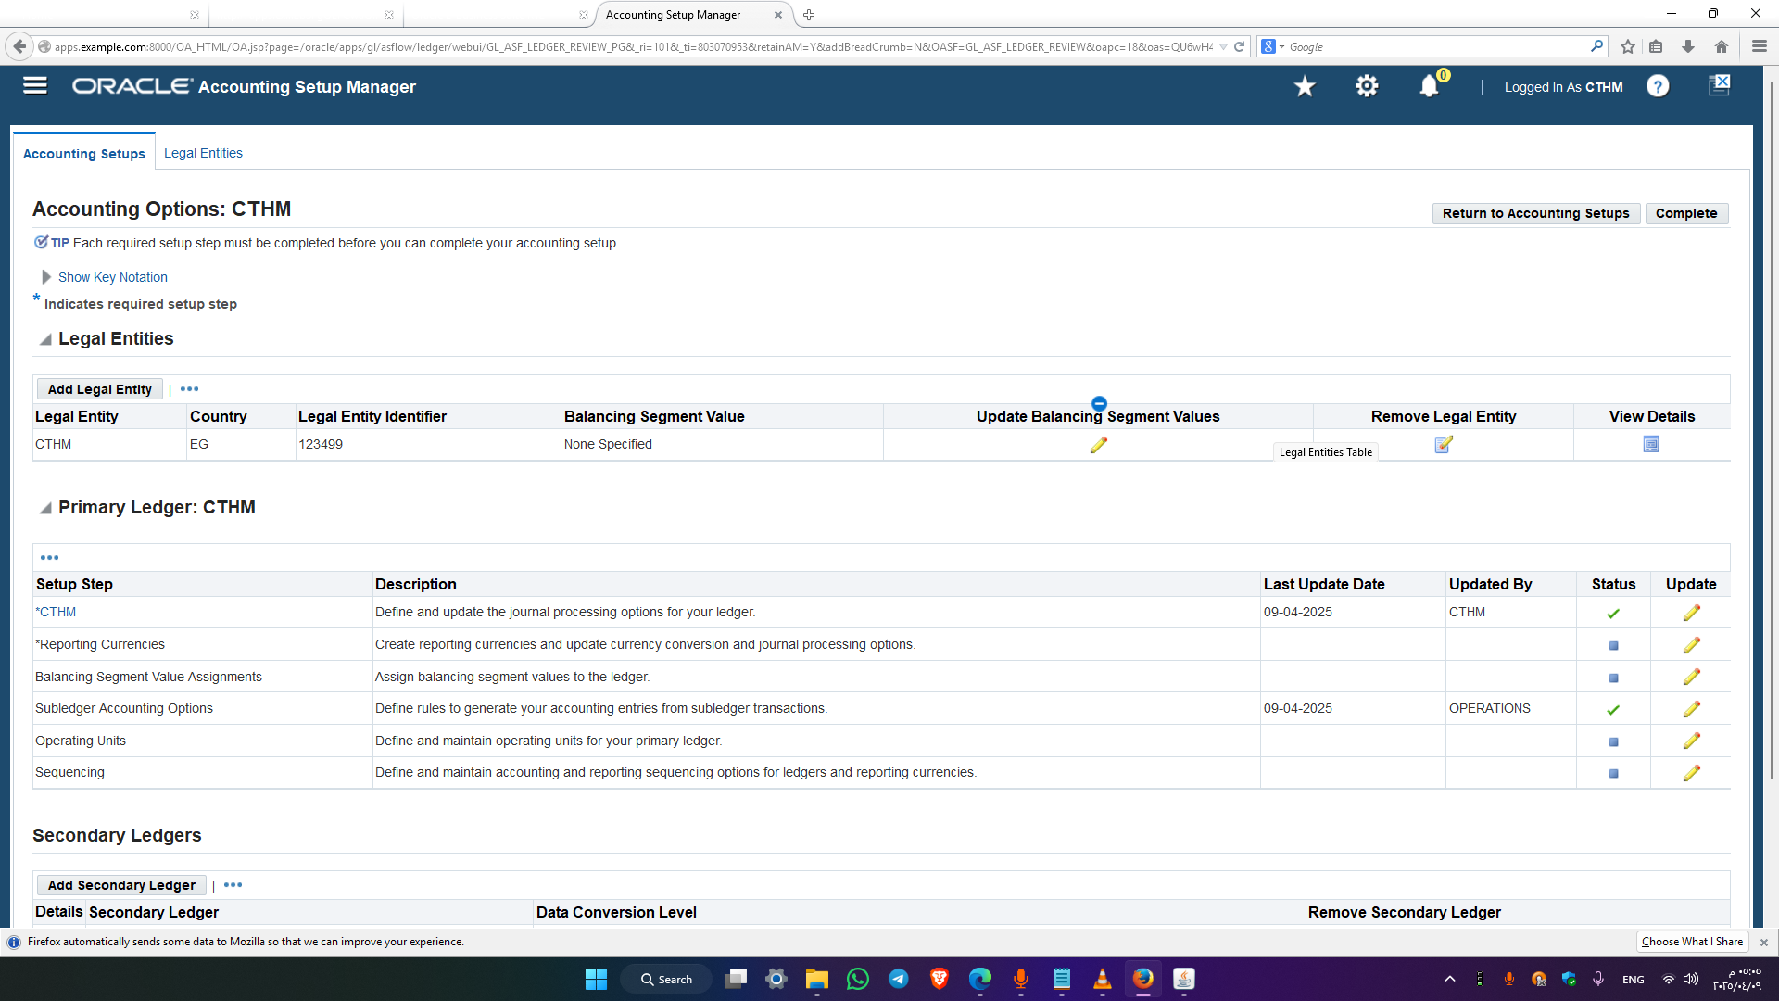
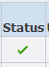
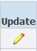
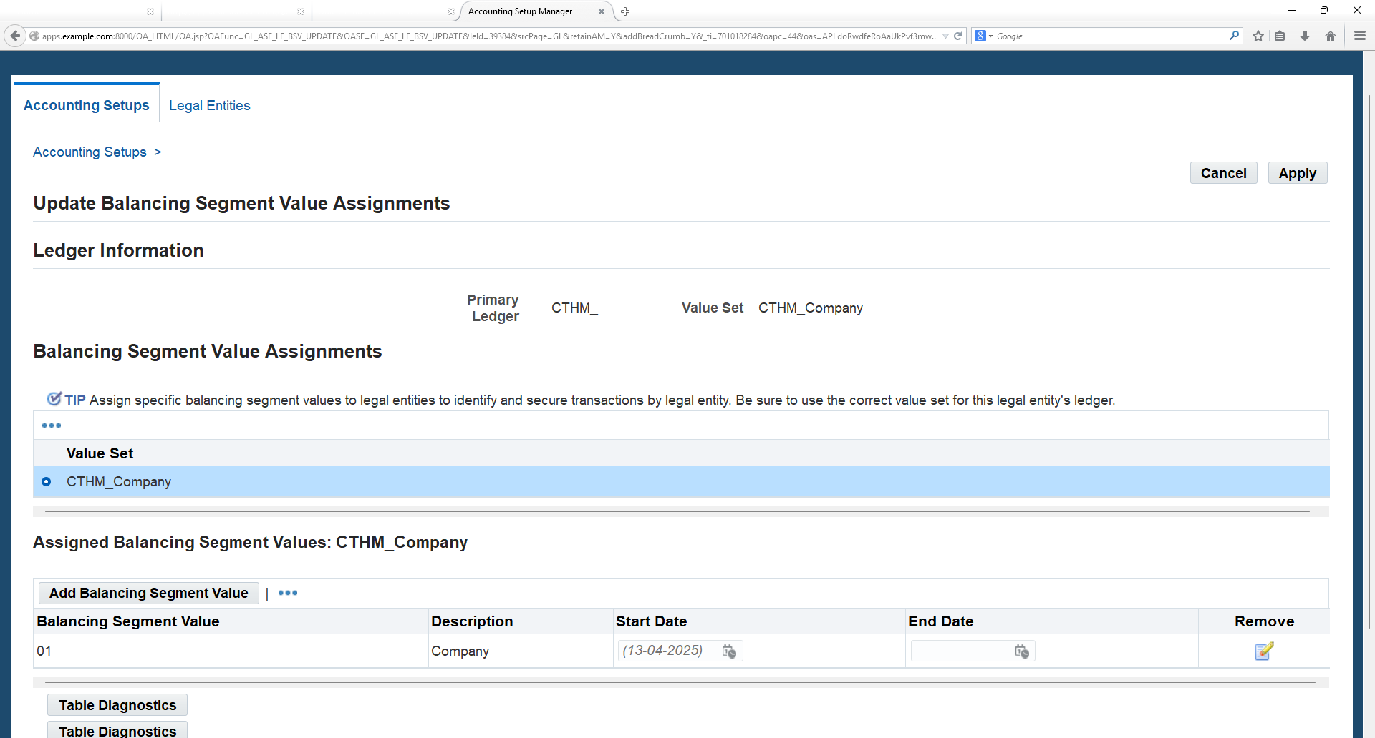
13
Check the status of the CTHM Ledger as
14
Click on Balancing Segment Value Assignments and click on Update icon
15
Click on Add Balancing Segment Value button and enter the Values then Click on “Complete” button

Slide 28
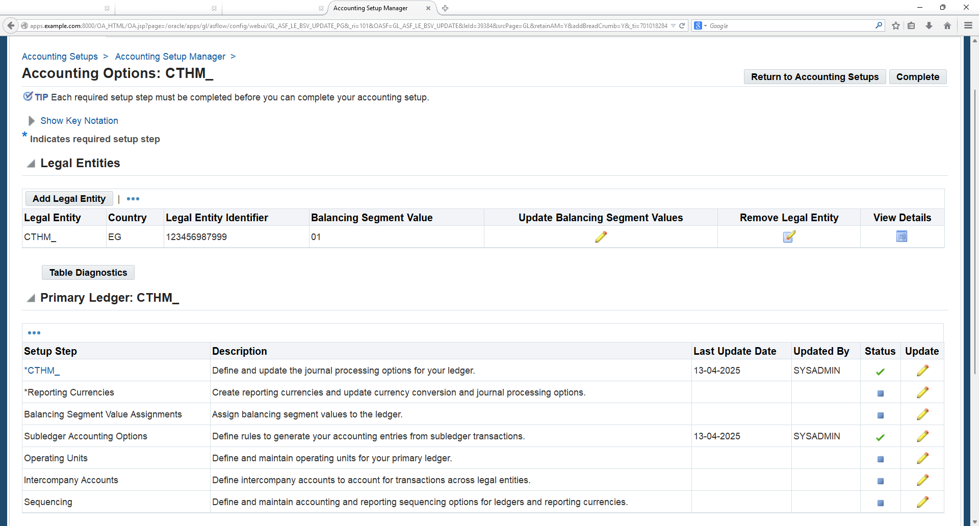
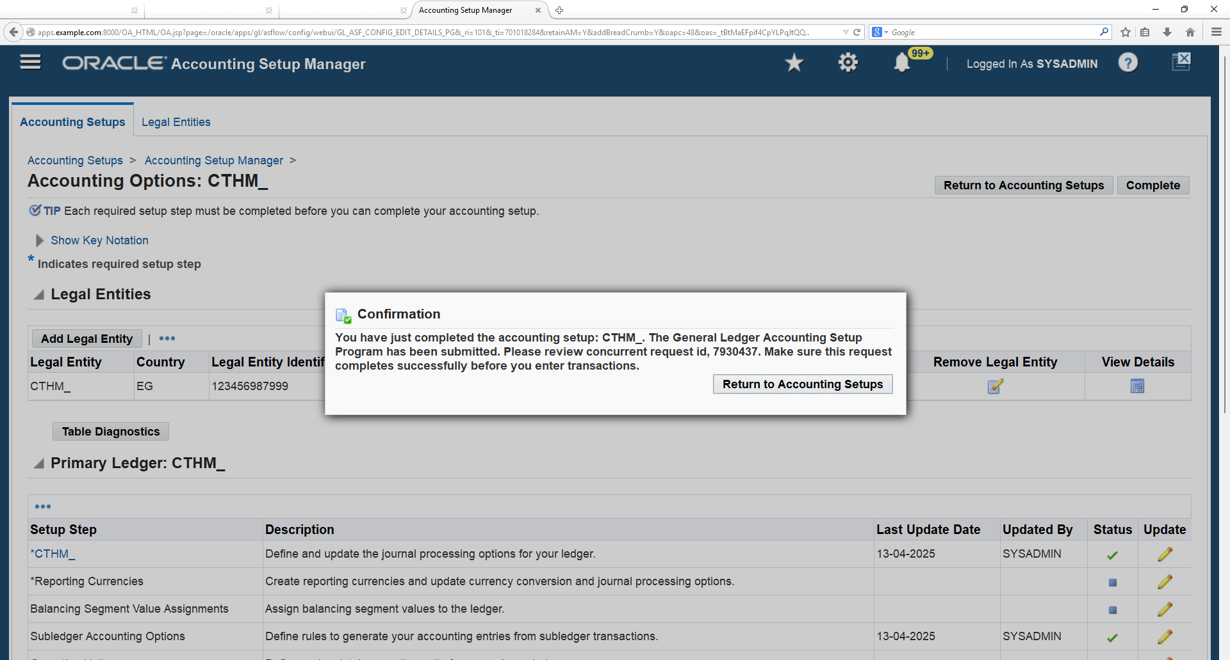
16
Check all the Setup step status are completed then Click on Complete
17
Click on “Return to Accounting Setups” button
18
Finally check the CTHM ledger status as completed

Slide 29
Ledger Set

Slide 30
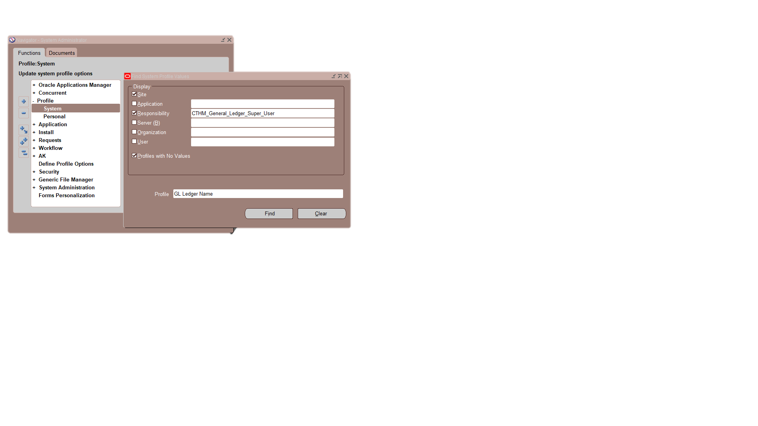
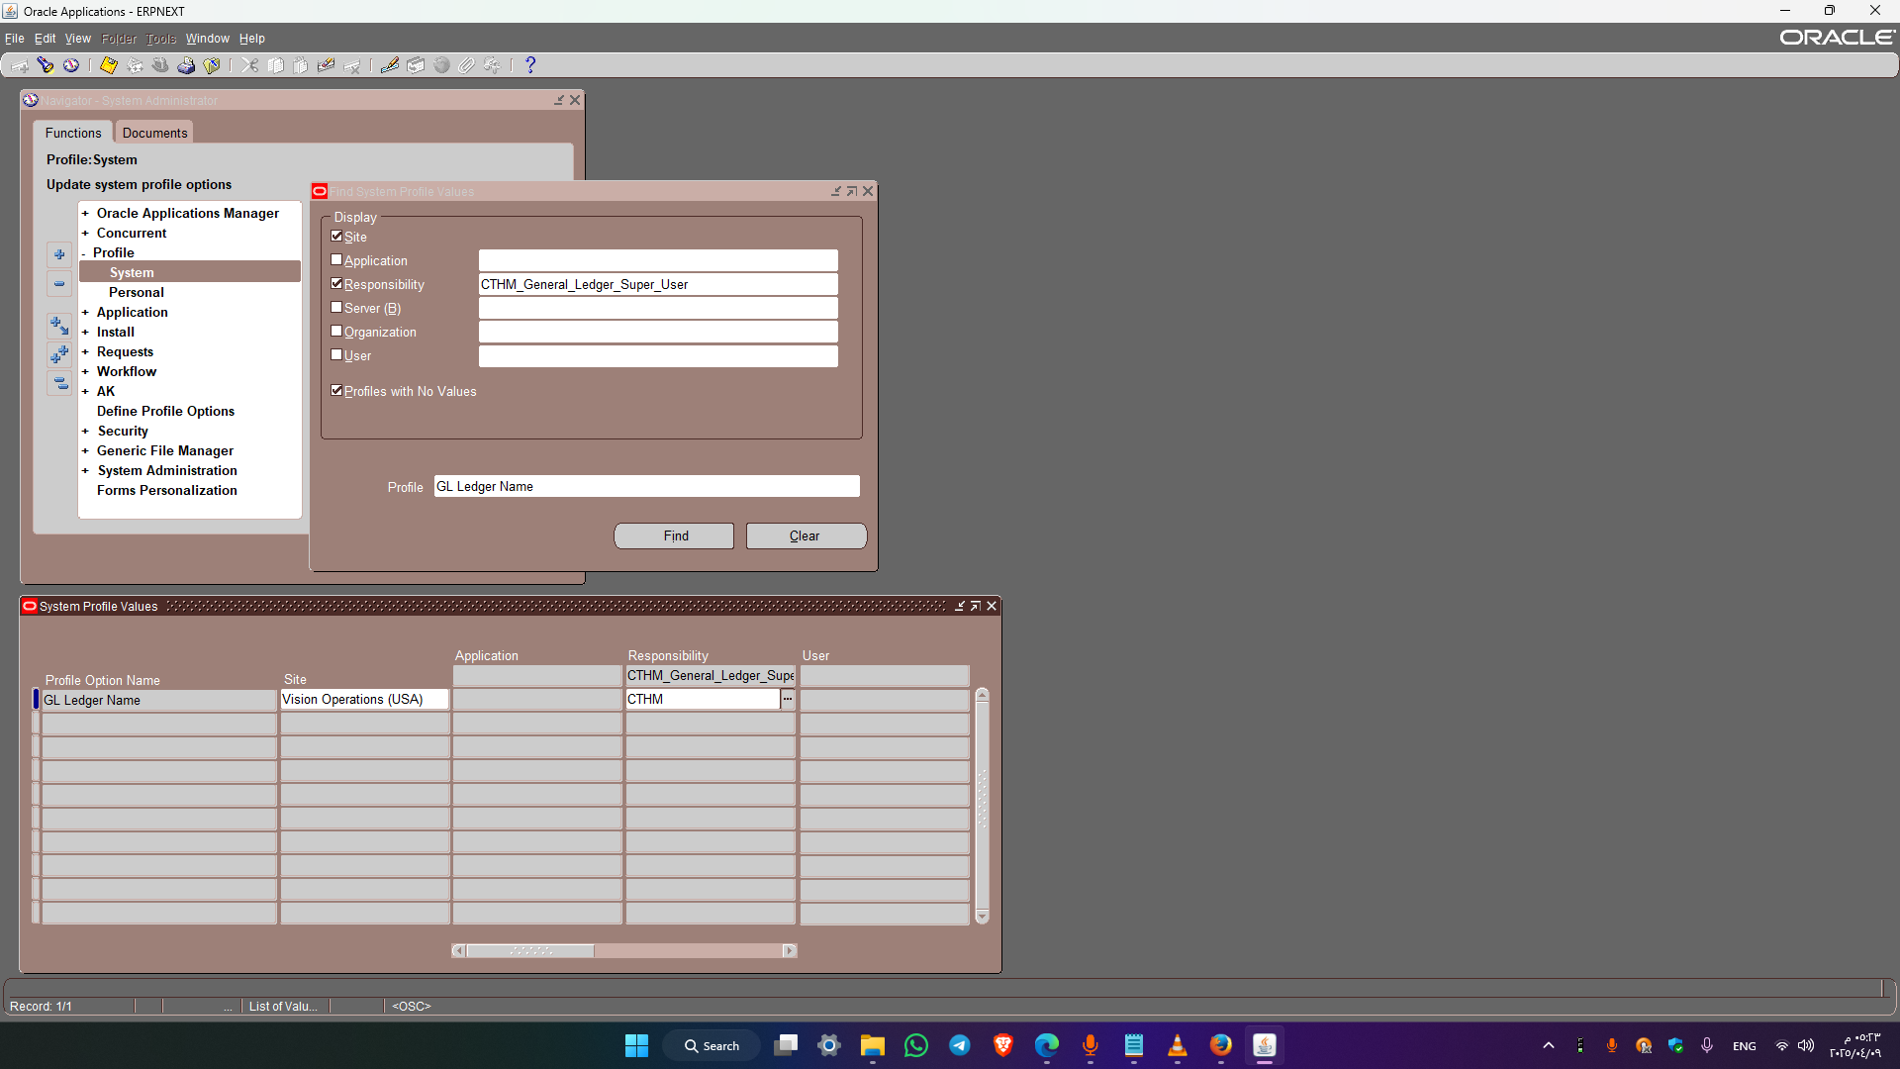
N: System Administrator → profile → system
Specify the Responsibility (e.g., CTHM_General_Ledger_Super_User) to link the Ledger accordingly.
Enter Profile name as „%GL%Ledger%Name%
Enter the Ledger Set name as CTHM that needs to be linked to the Responsibility

Slide 31
Open Periods

Slide 32
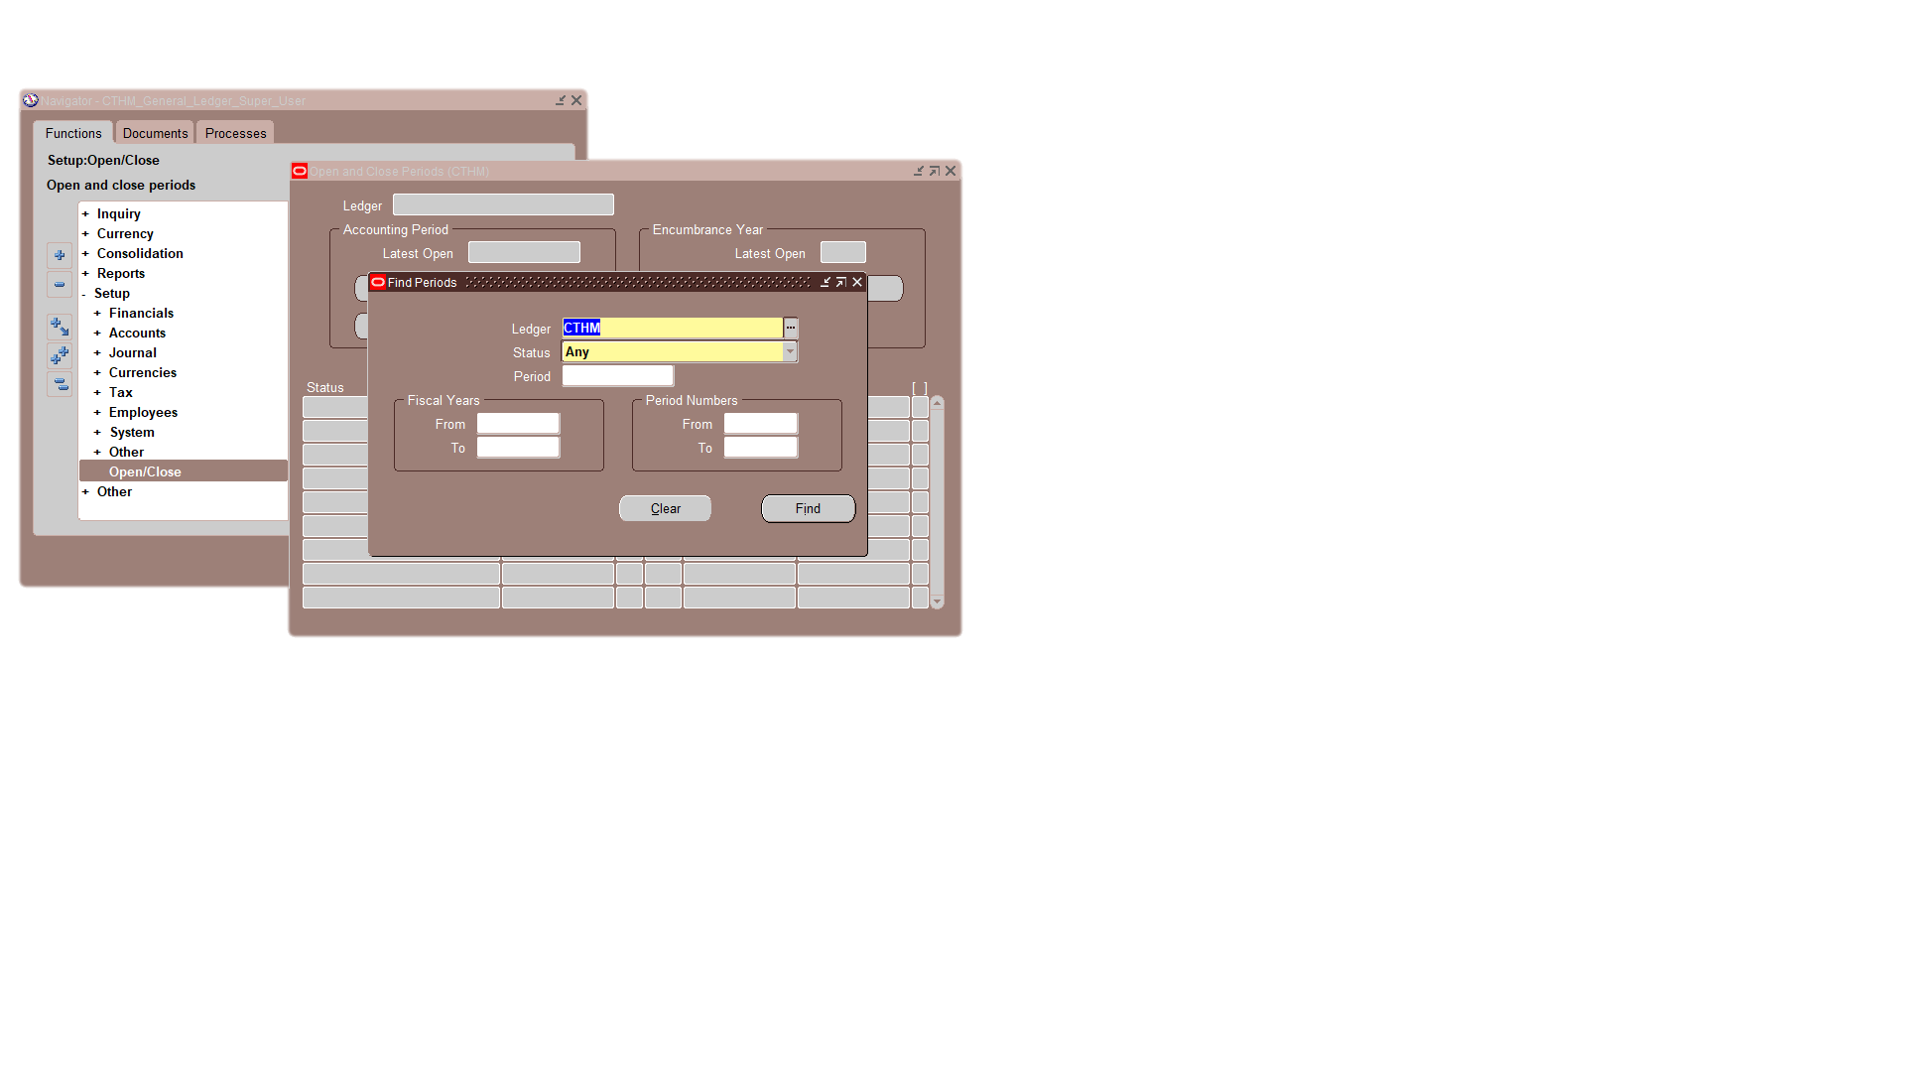
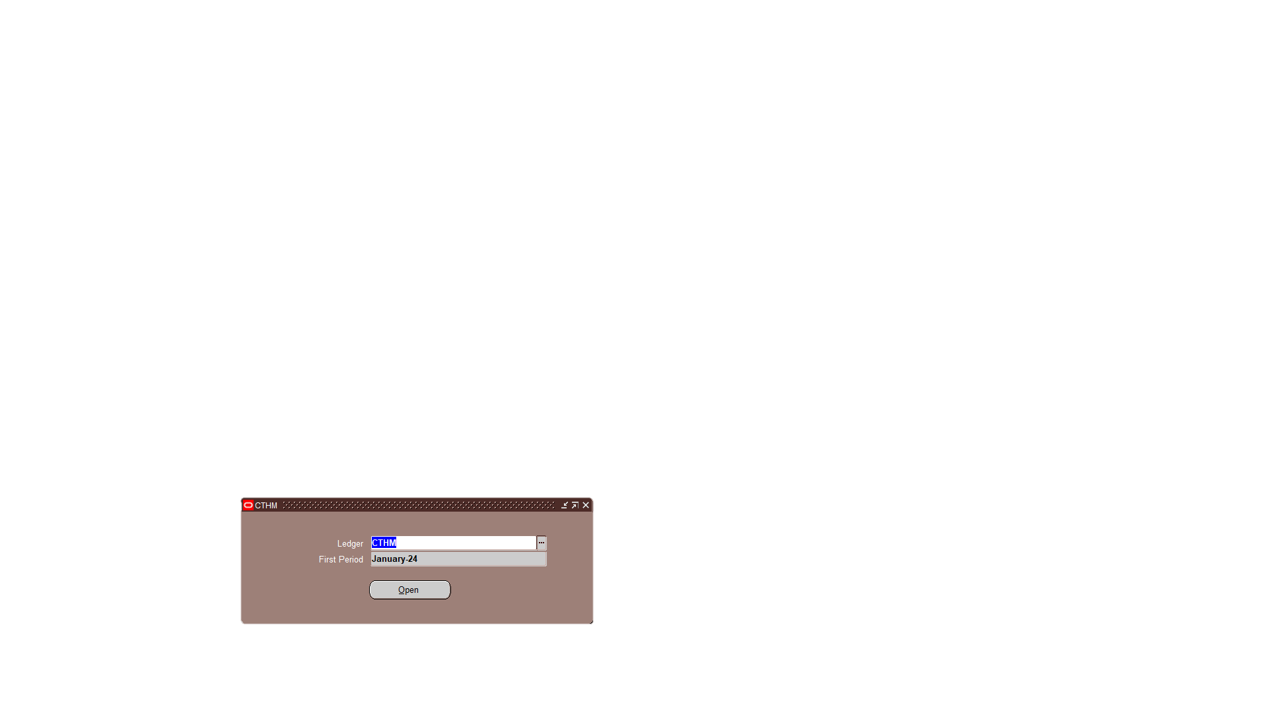
N: Setup → Open/Close
Enter the Ledger name as CTHM and click on Find button
Enter the Ledger name as CTHM and First period as January-24 and click on open button
A concurrent Program Open period is run by system automatically

Slide 33
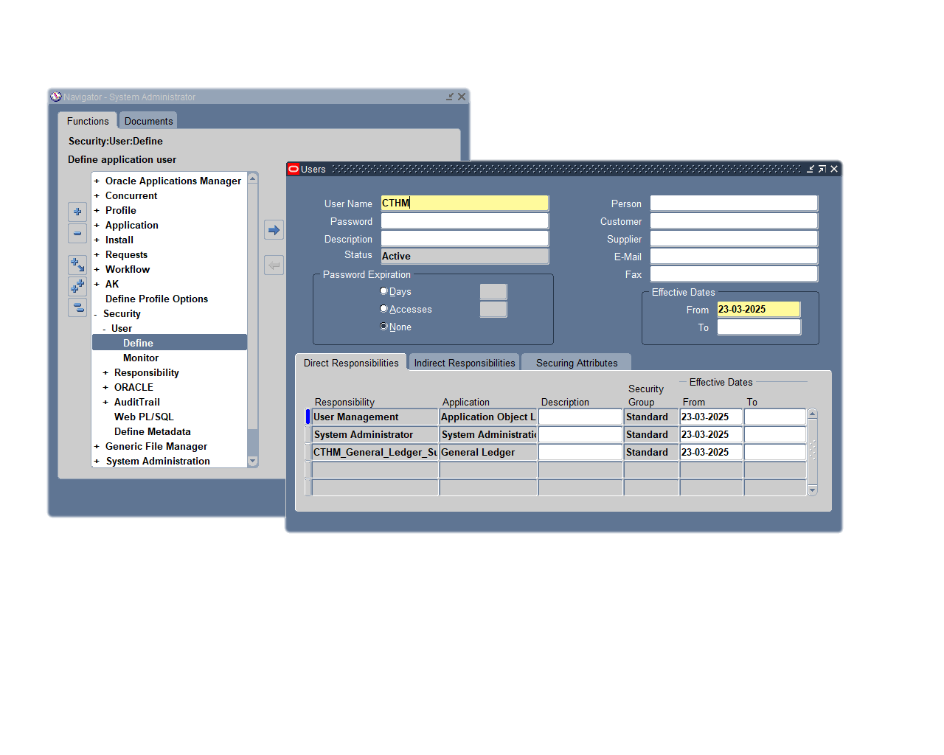

Preliminary Step: Creating a User and Assigning Responsibilities
System Administrator → Security → User → Define.

